Slide 1
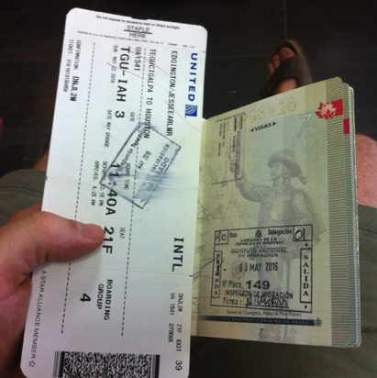
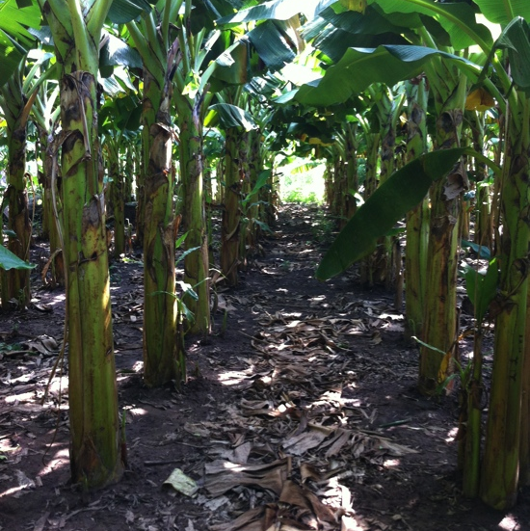
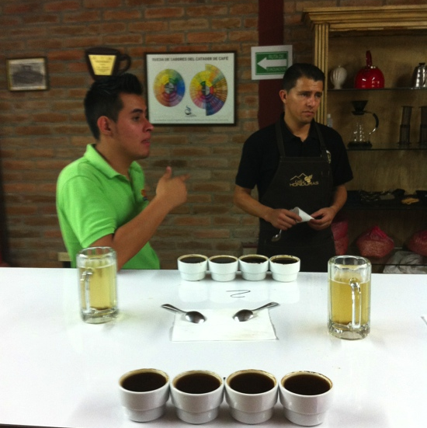
Honduras Water project 2016
In partnership with NADC, King’s University and World Renew
(My passport stamped from the land of coffee and banana's)
A story in pictures: By Jesse Edgington

Slide 2
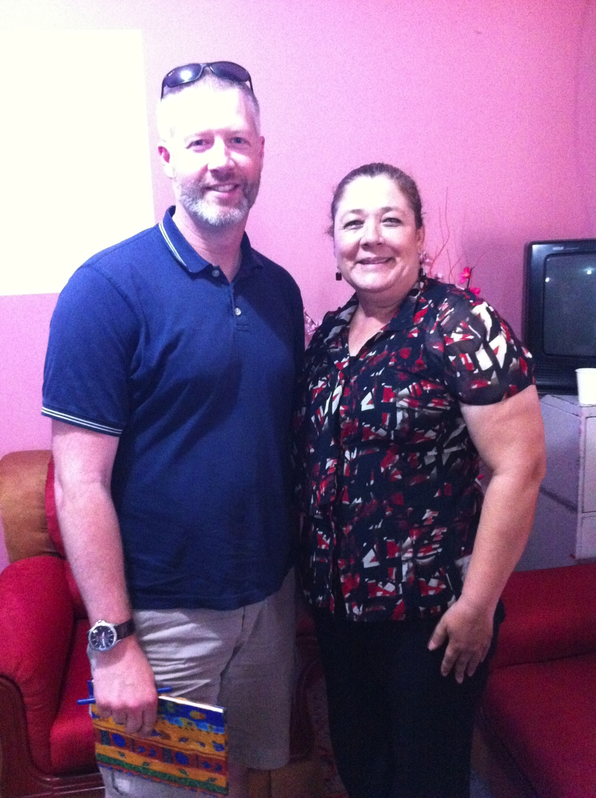
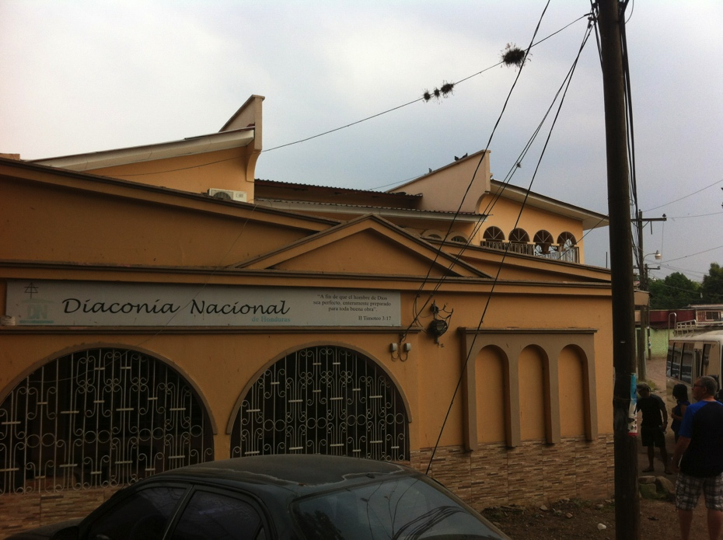
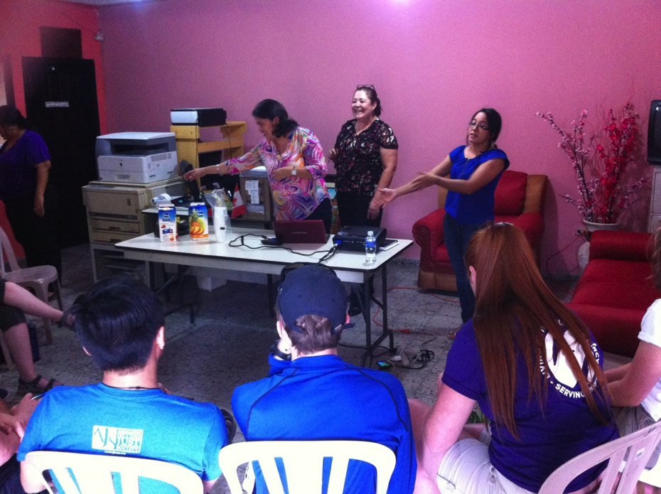
Meeting with our partners in Honduras; Diaconia Nacional and their director, Delia
Notes:
----- Meeting Notes (2016-06-02 13:54) -----
- diaconia programs include water projects, community health programs, biblical teaching and training, food security programs and community leadership training.
- they had 12 community visits before we arrived

Slide 3
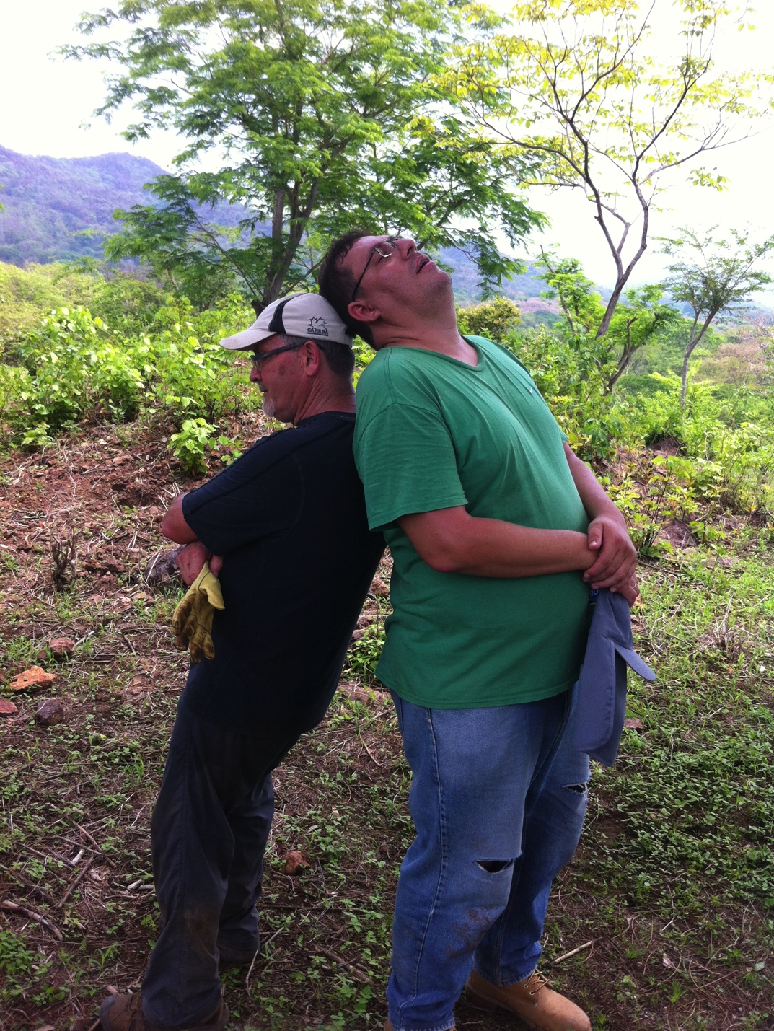
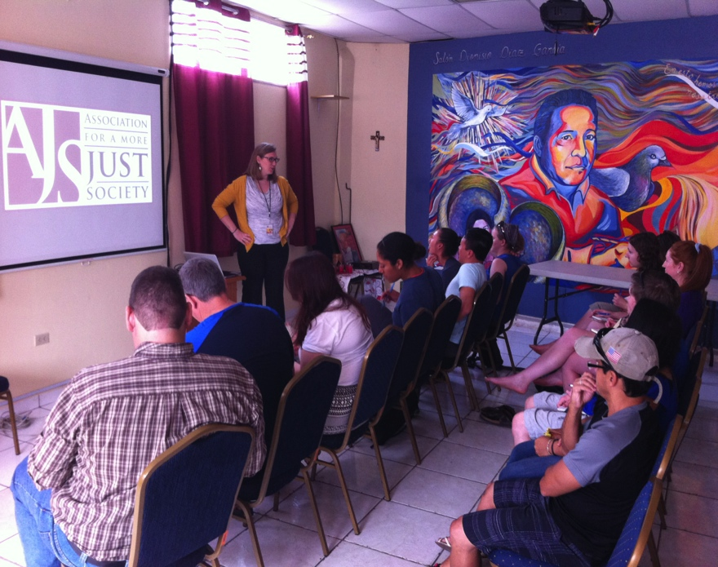
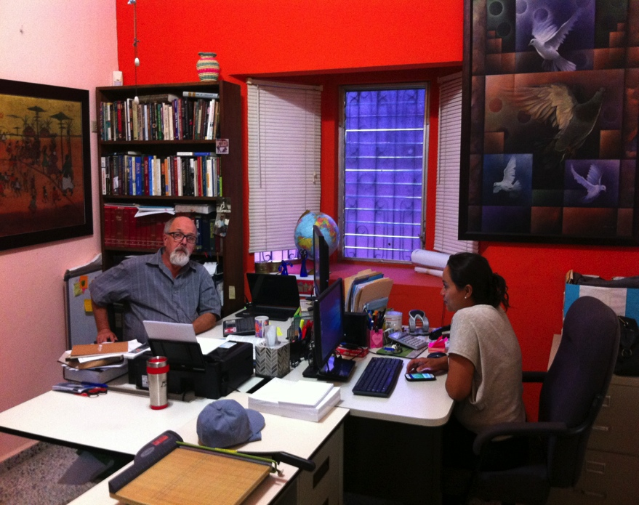
The King’s University and World Renew partners: Represented by Roy Berkenbosch and Rolando Pinzon
Notes:
----- Meeting Notes (2016-06-02 13:54) -----
-the other major partners are world renew and King's
- there is a large learning and justice component, emphasised by our visit to AJS

Slide 4
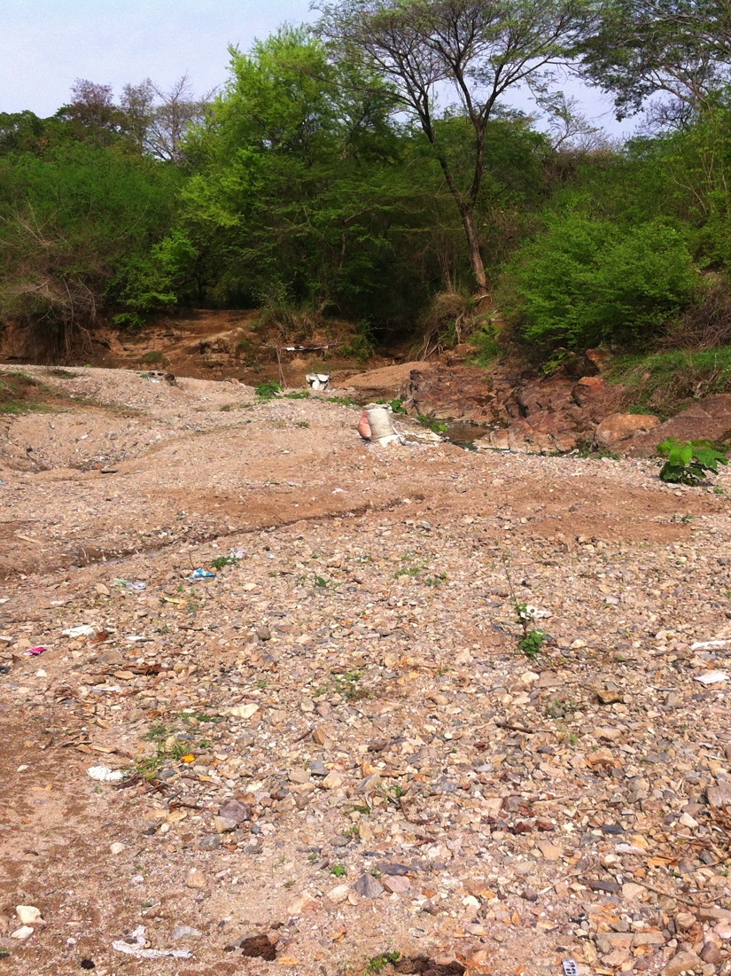
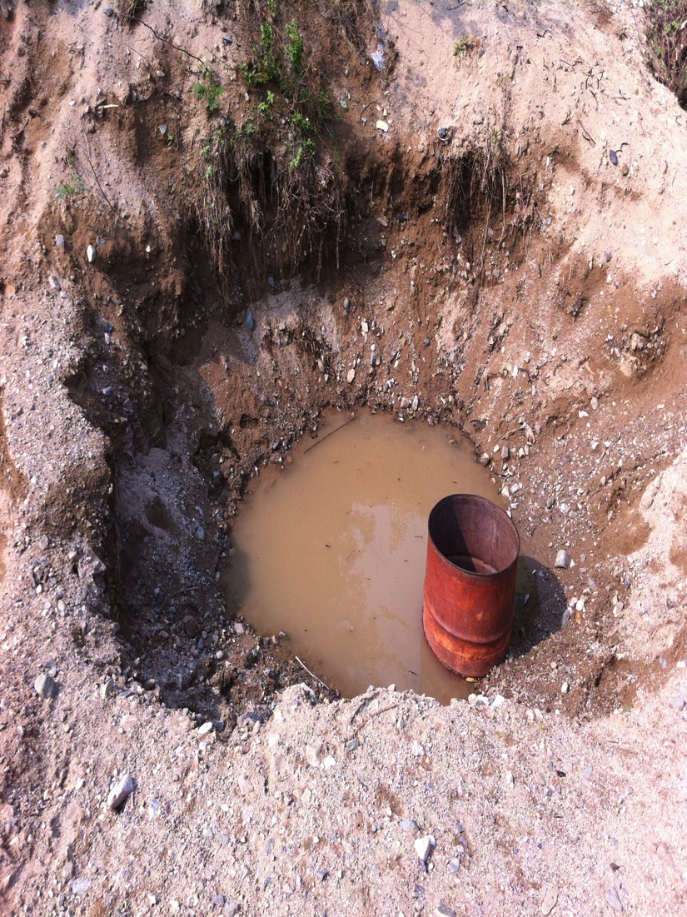
They have had to dig a hold in the riverbed and insert a barrel to get still, semi-clean water to rise up and settle into the barrel. It’s used for cleaning, washing, cooking and drinking.
At the end of the dry season, this is the current source of water for the village… a dried up river.
Notes:
----- Meeting Notes (2016-06-02 14:08) -----
-almost a hundred families in this community, all living with only this access to water for drinking, cleaning and washing

Slide 5
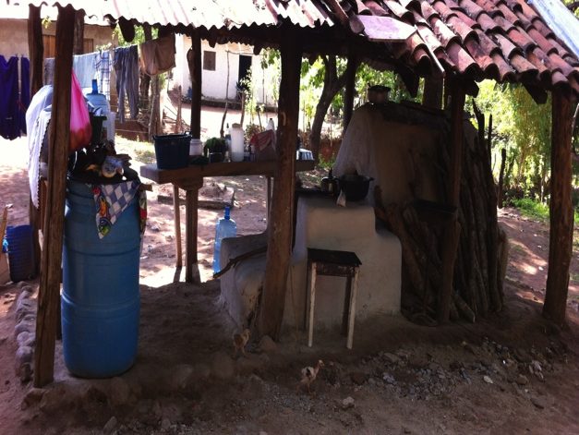
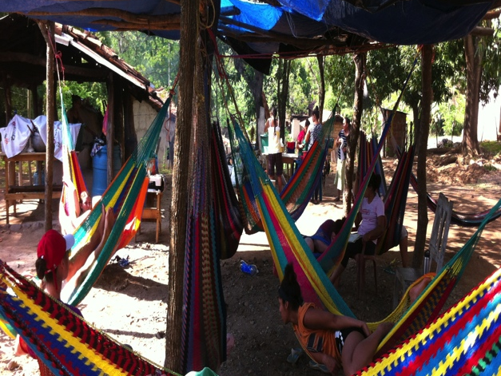
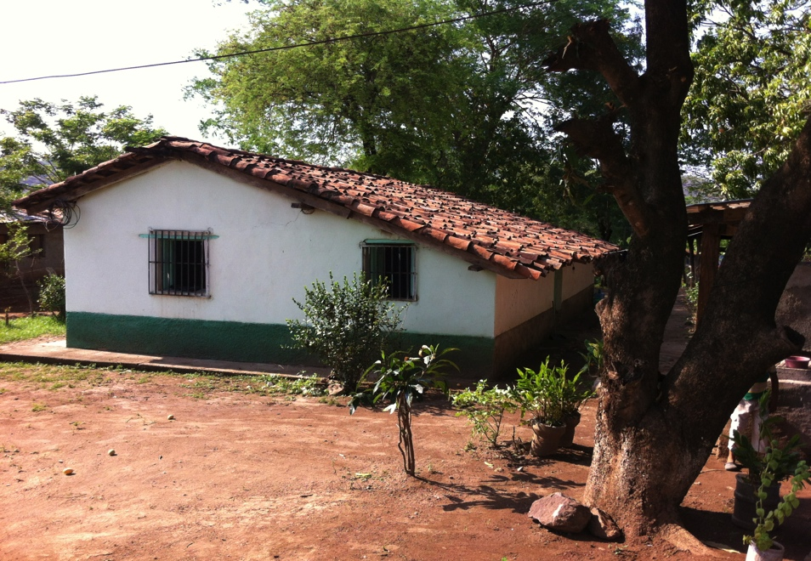
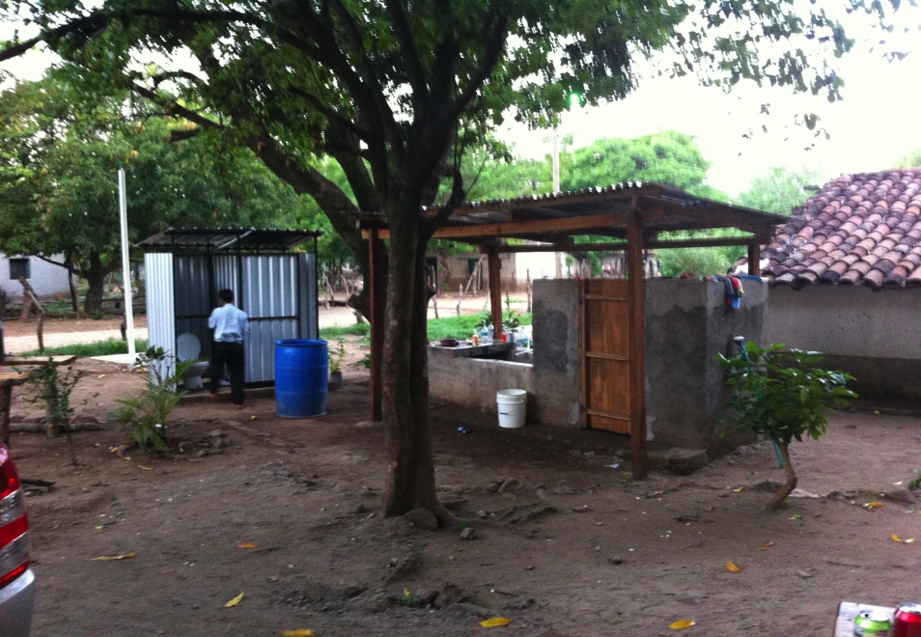
Cooking facilities
Relaxing in hammocks
Sleeping quarters
Washrooms and shower
Notes:
----- Meeting Notes (2016-06-02 14:08) -----
-brought us hammocks out of their own supply

Slide 6
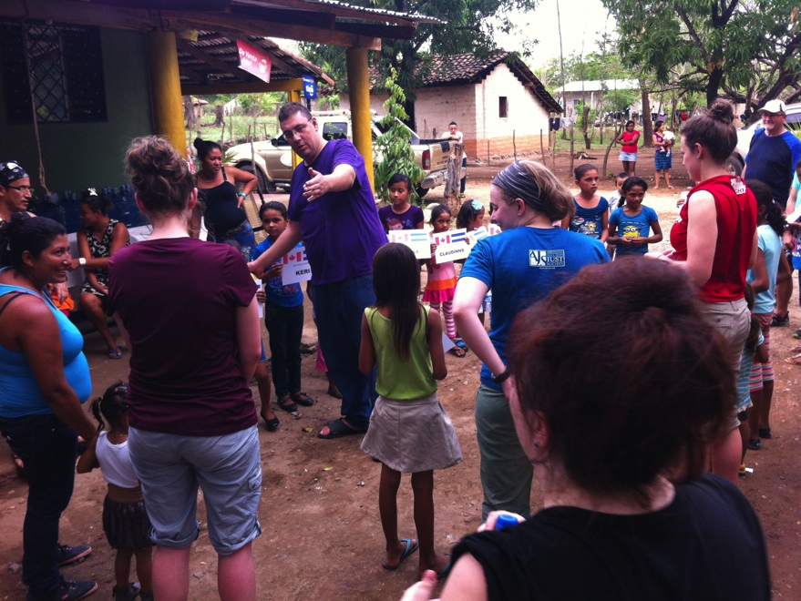
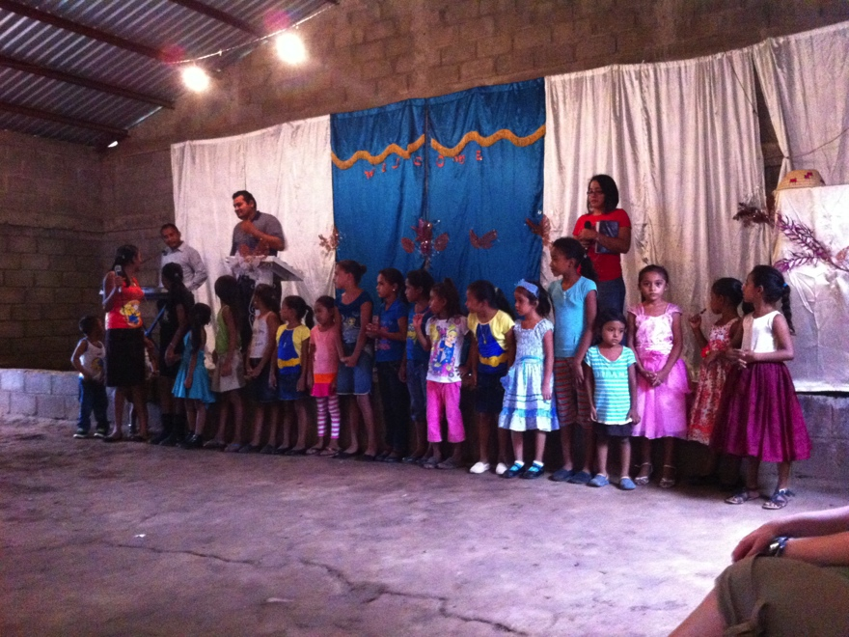
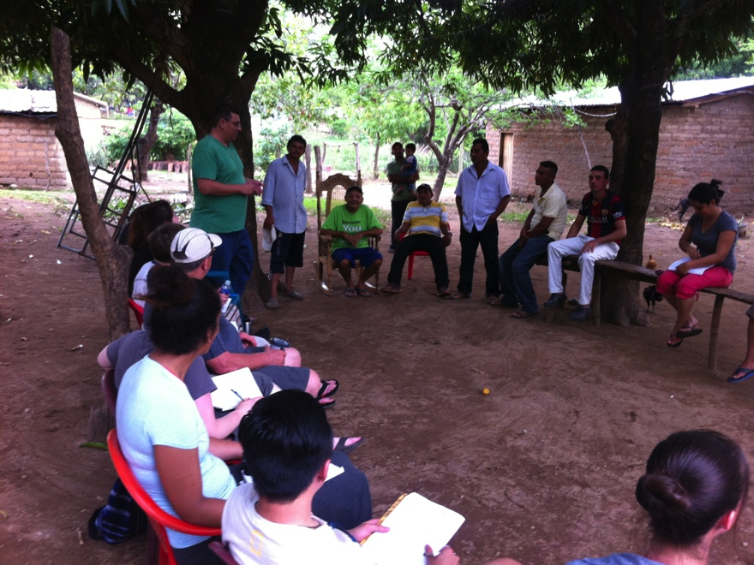
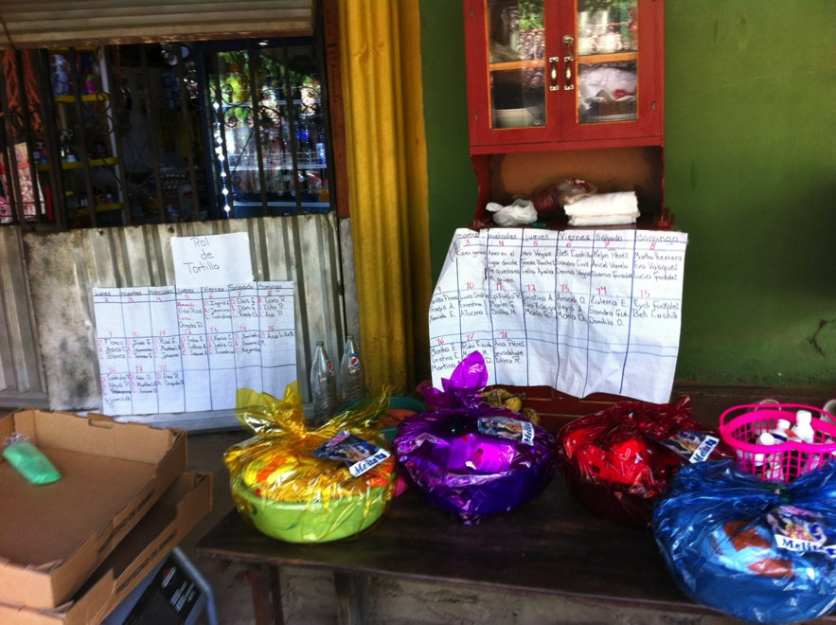
A warm welcome
Introductions and blessings
Meeting with community leaders
A community organized and equip
Notes:
----- Meeting Notes (2016-06-02 13:54) -----
-God evident in the hospitality shown in welcoming strangers.
-They were so thankful that we would give up our time and leave our homes to come and help
-community was organized, our needs were met in abundance

Slide 7
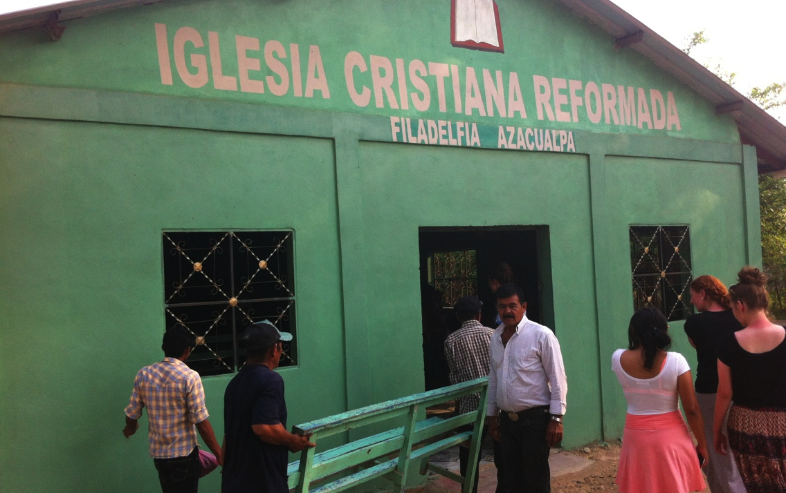
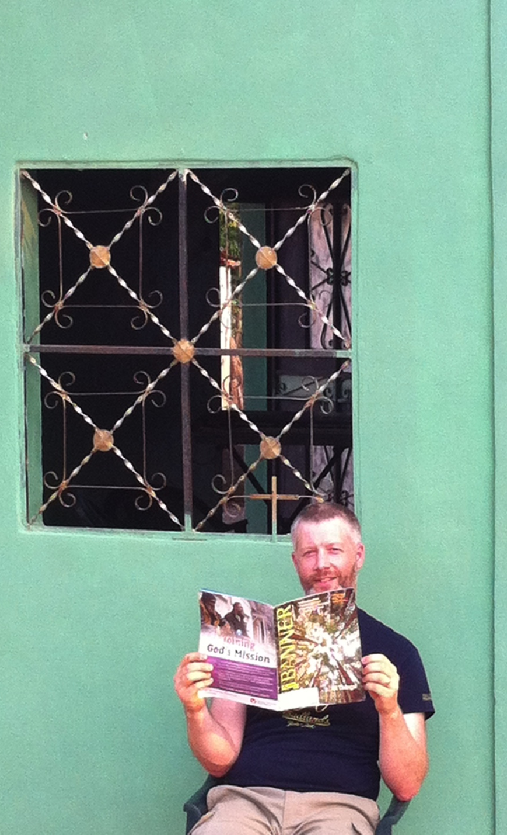
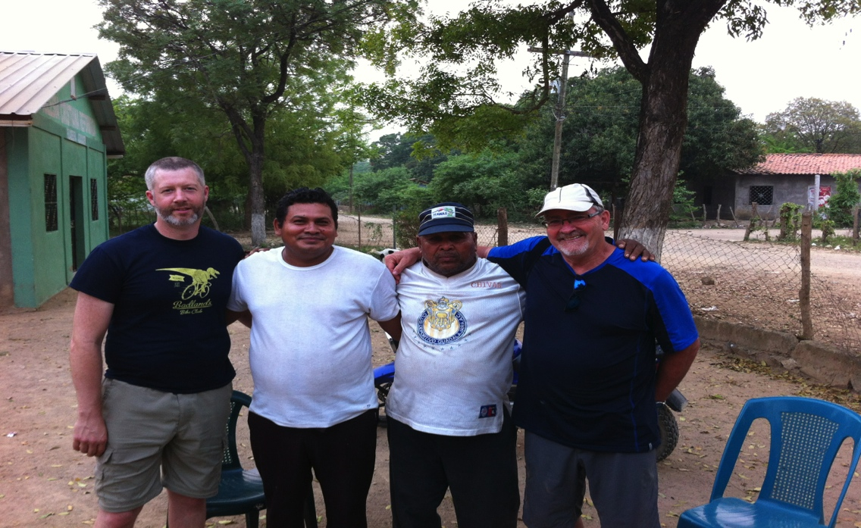
Visiting the CRC in the neighboring community and meeting the pastor and his father.
Notes:
----- Meeting Notes (2016-06-02 14:08) -----
-neighboring CRC in Azacualpa with ties to our community in Varsovia. Right next door.

Slide 8
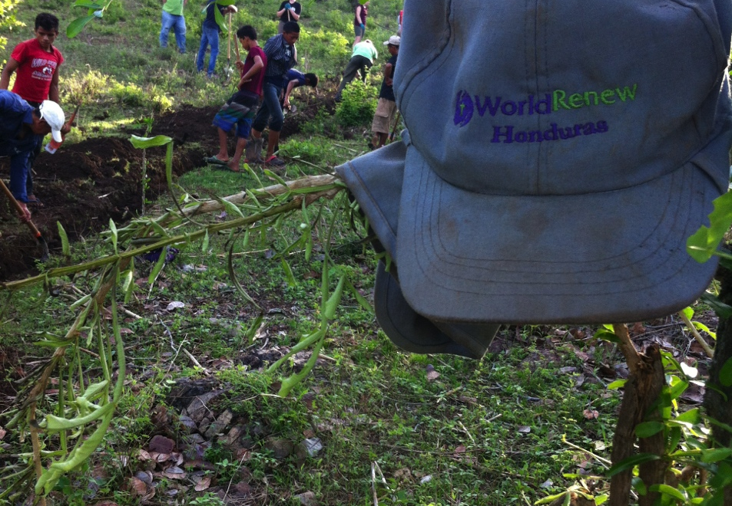
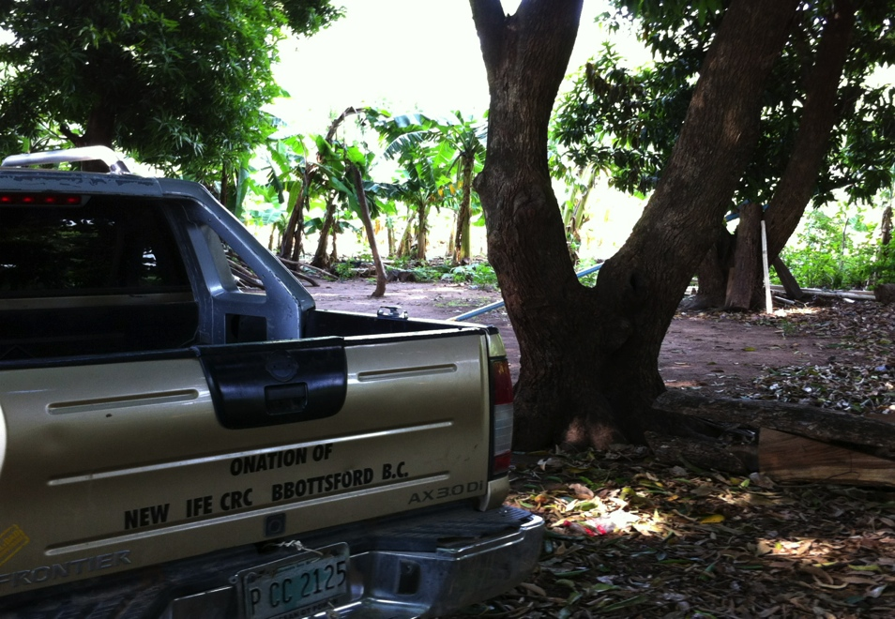
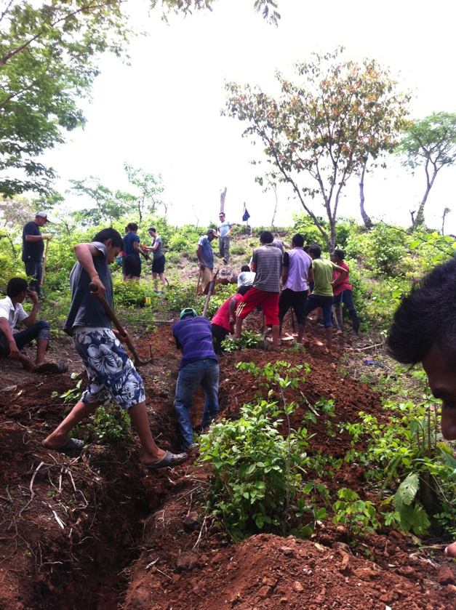
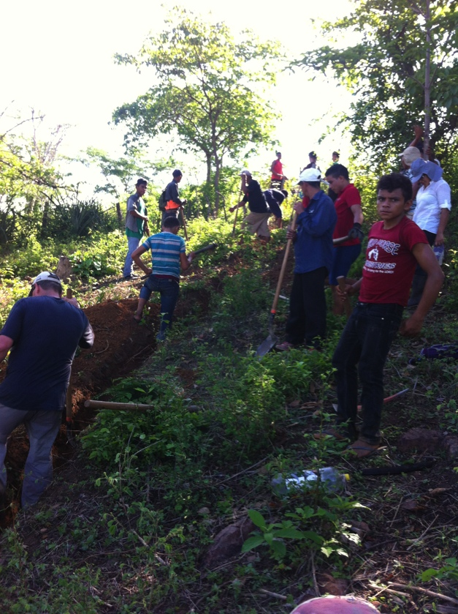
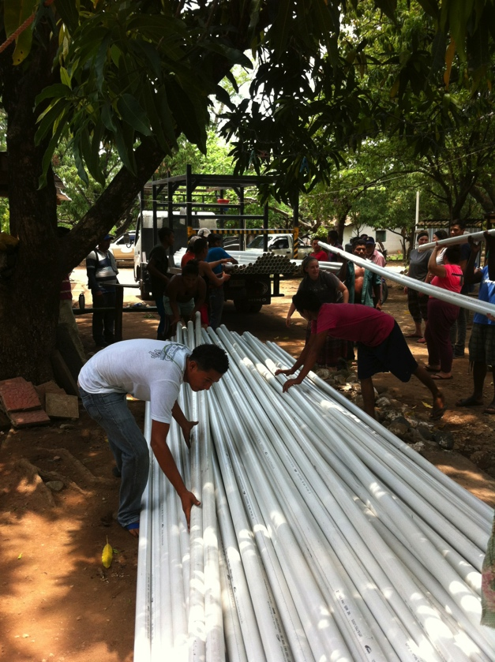
Working at digging trenches in 35 Celsius weather was a challenge but when the pipes arrived, we celebrated!
Notes:
----- Meeting Notes (2016-06-02 13:54) -----
-psalms of praise could have been wrote and sung when the pipes arrived
-hope and excitement were evident

Slide 9
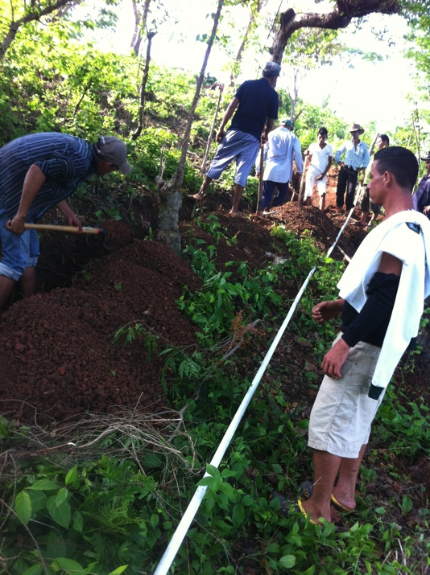
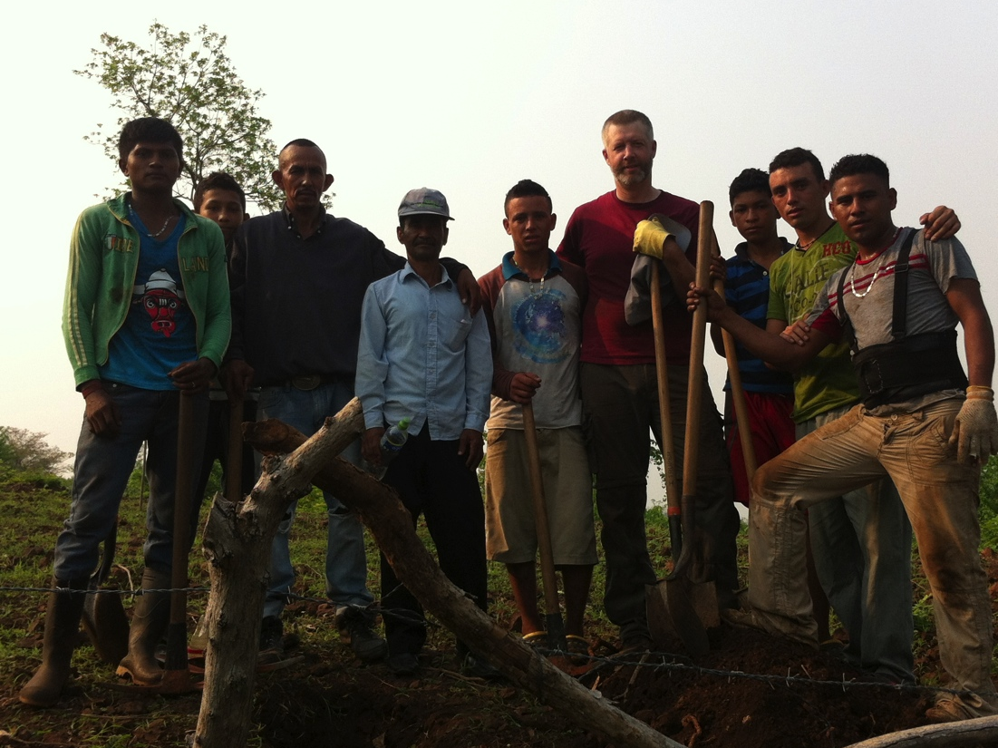
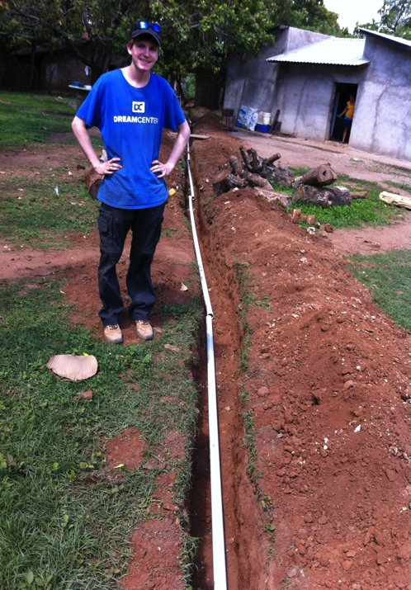
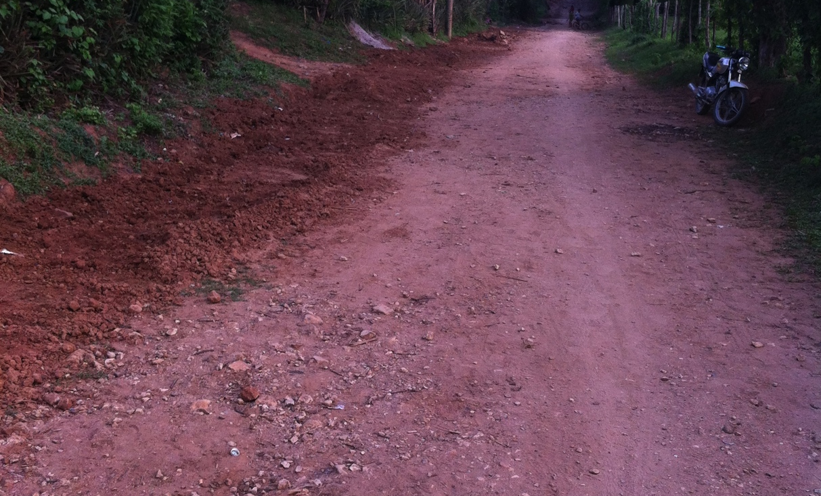
A lot of digging, piping and covering over was accomplished, along with building a sense of community and friendship.

Slide 10
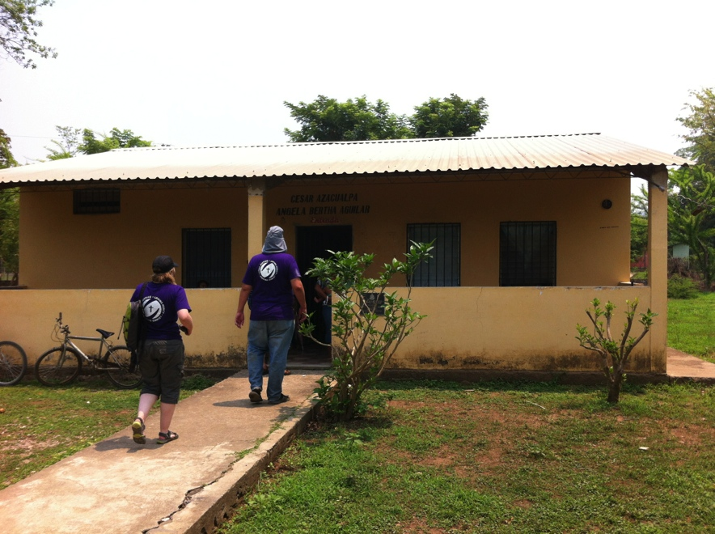
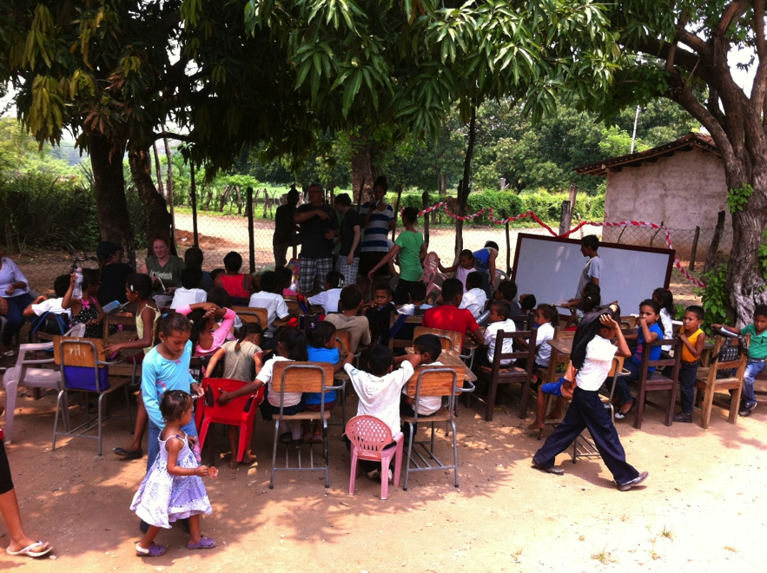
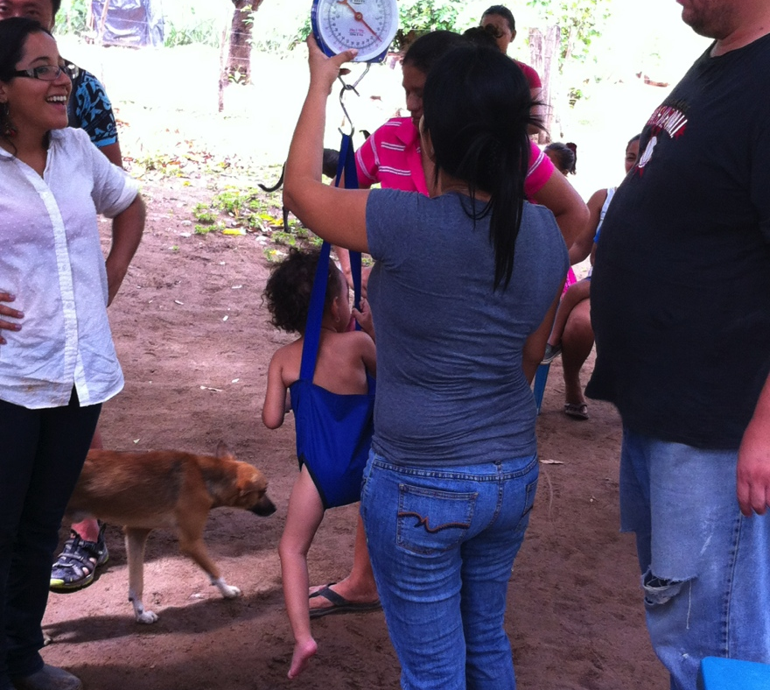
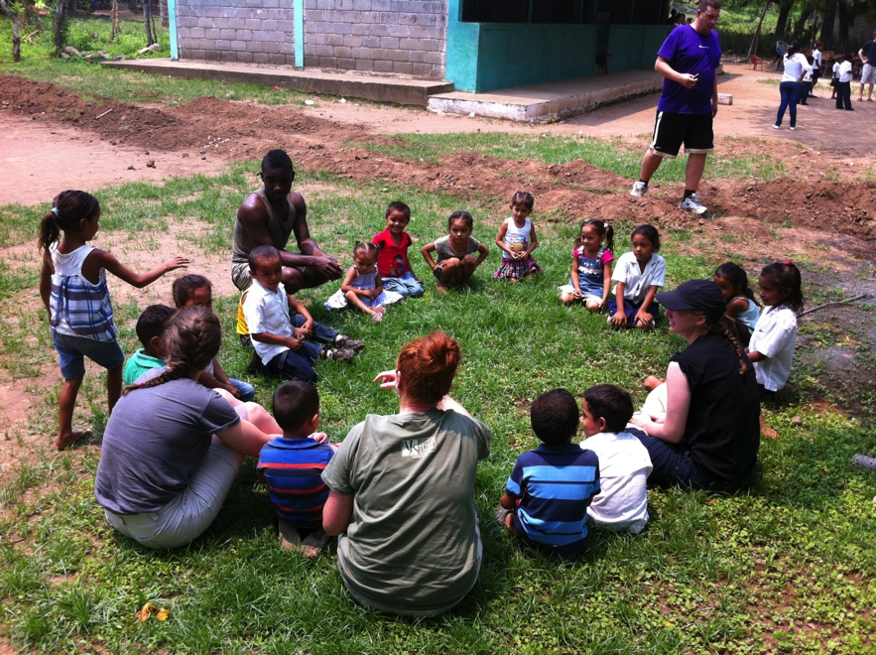
Health Clinic
Community school K-6
Learning and serving opportunities
Community Health program
Games with the children
Notes:
----- Meeting Notes (2016-06-02 13:54) -----
-health struggles emphasised in difficulty of lack of good food available, problems with diseases like diabetes and mosquito born diseases
-water would improve ability to grow local gardens and allow kids better health and more time to consistantly go to school
-can you imagine a health clinic with no water?

Slide 11
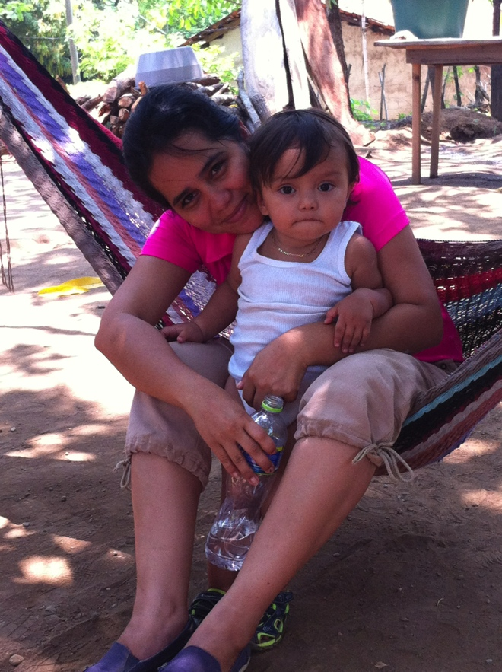
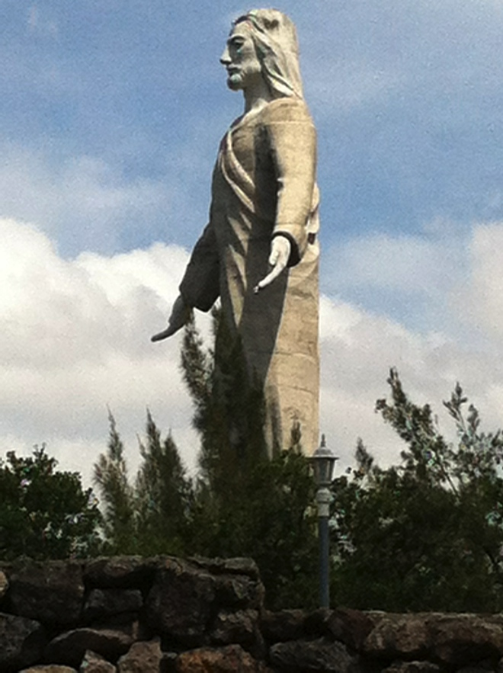
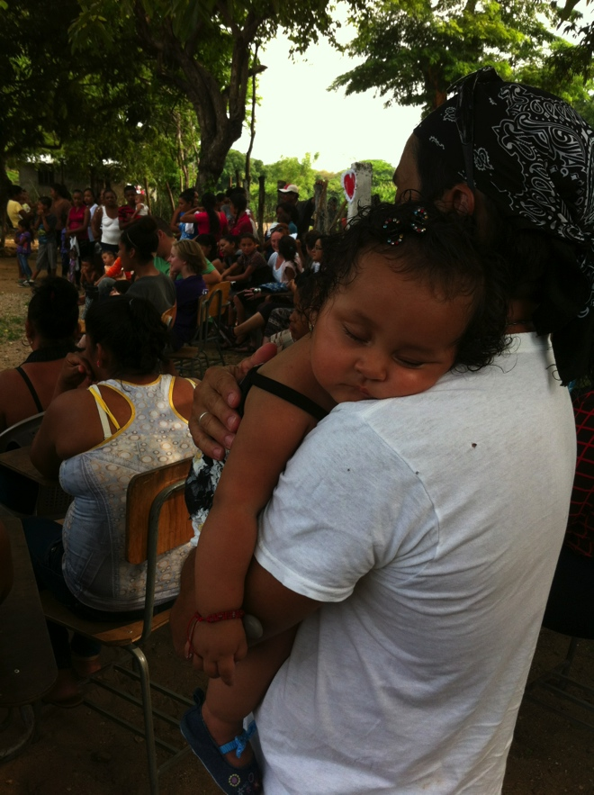
Many stories of people’s lives to share and celebrate
Single mom working for Diaconia Nacional in the community as a community health nurse
Jesus Christ risen; to save and watch over His children and His church everywhere
A community full of children and babies; for the kingdom of God is theirs
Notes:
----- Meeting Notes (2016-06-02 13:54) -----
-relationships were made, stories of their lives were shared
-Margarita and Mario
-children were offered into the arms of brothers and sisters

Slide 12
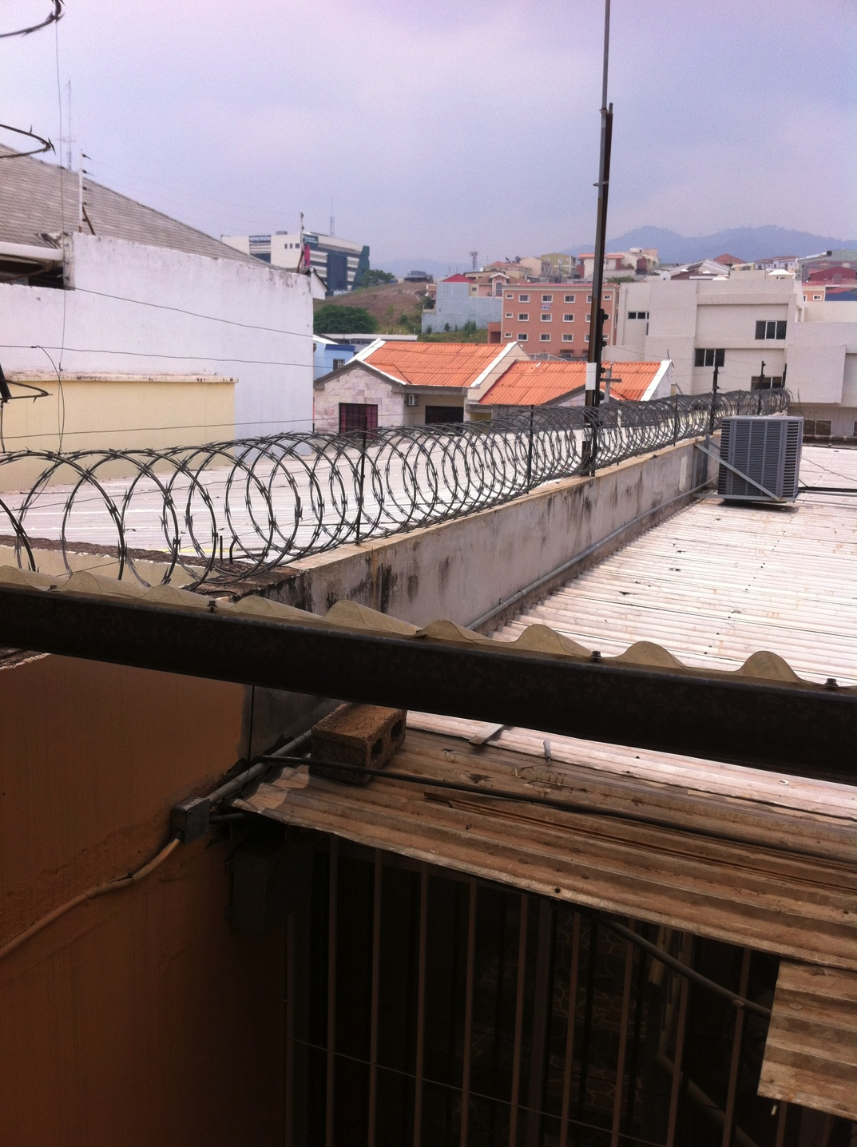
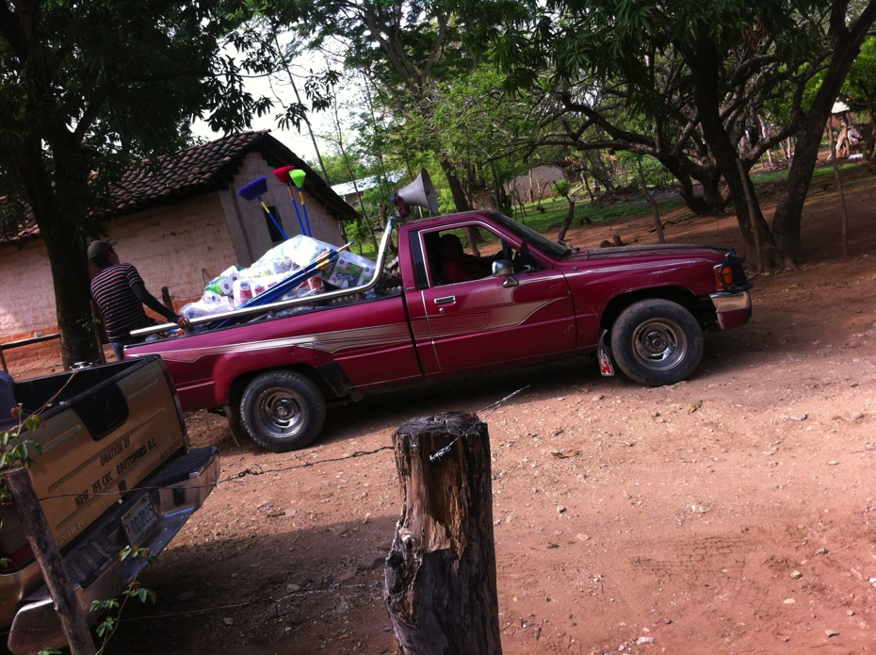
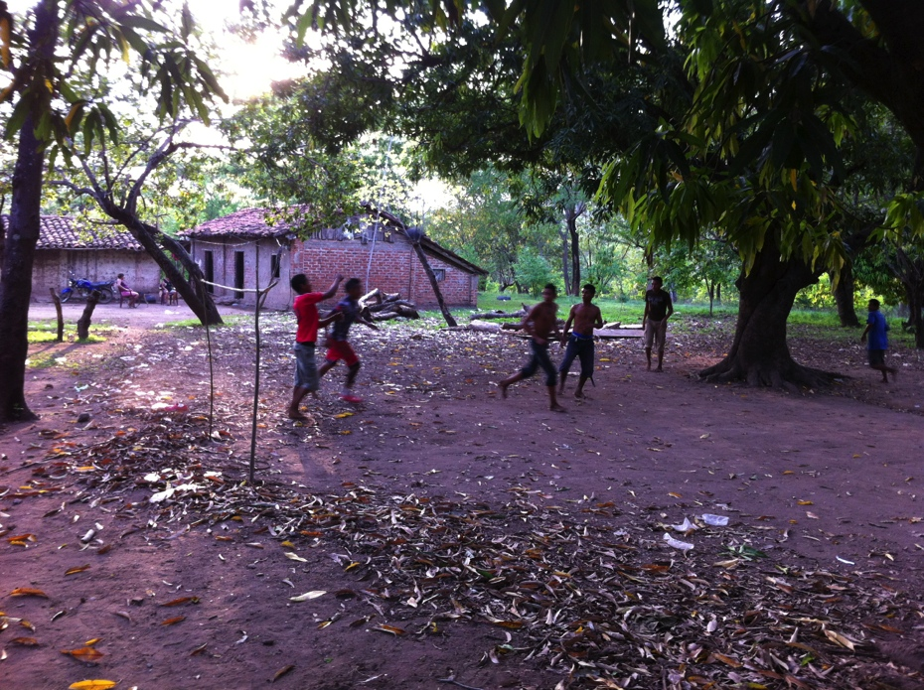
At times it was odd to see so much barbed and razor wire for “security” but in rural areas it seemed safer and we saw activities of commerce and recreation.
Notes:
----- Meeting Notes (2016-06-02 13:54) -----
-security and safety were often shown in a visible way, guns and razor wire were everywhere
-villages a little more safe, but the way of life was more basic and challenging
-transportation was a problem and much had to brought into the community

Slide 13
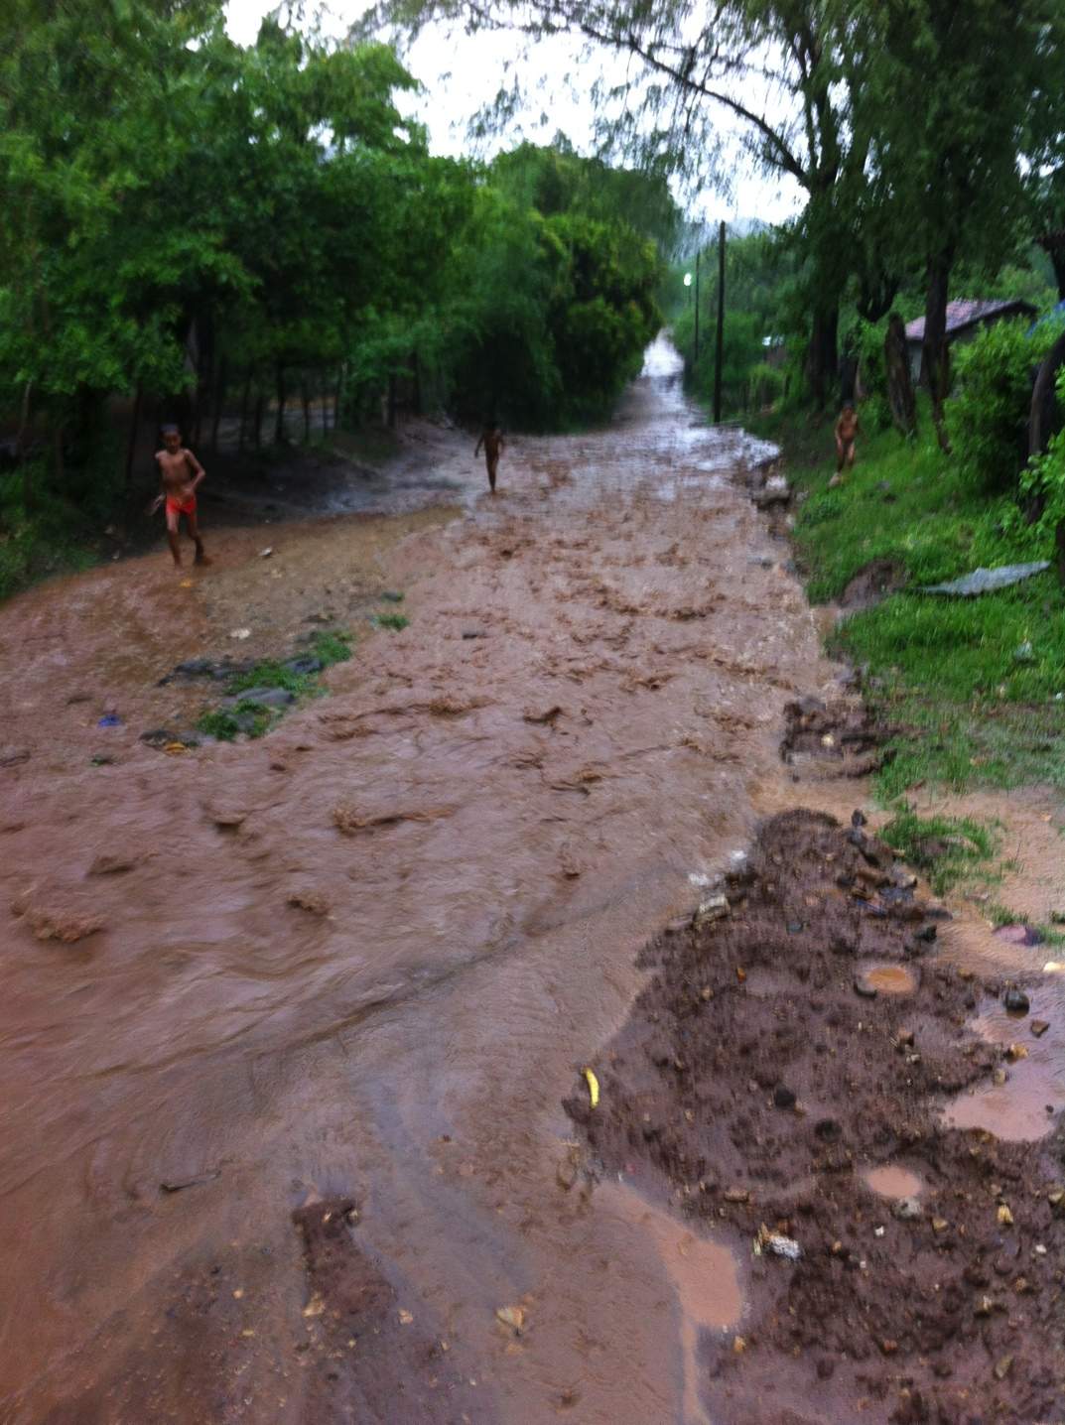
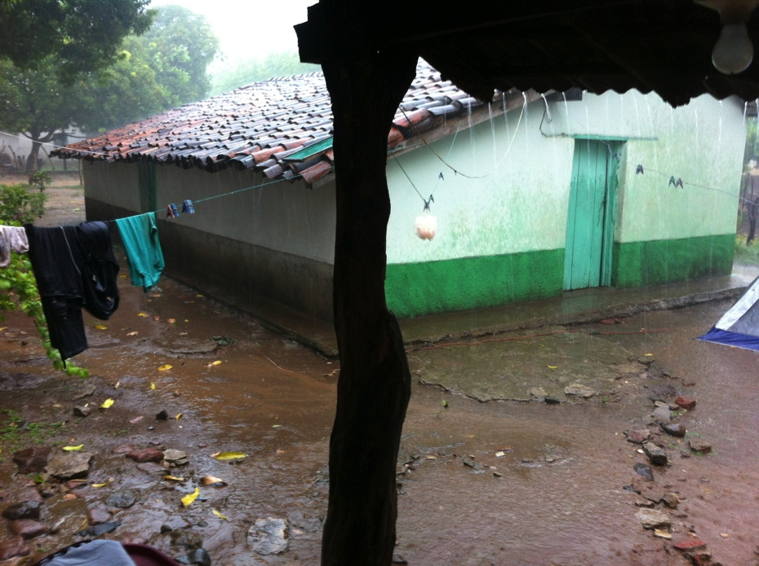
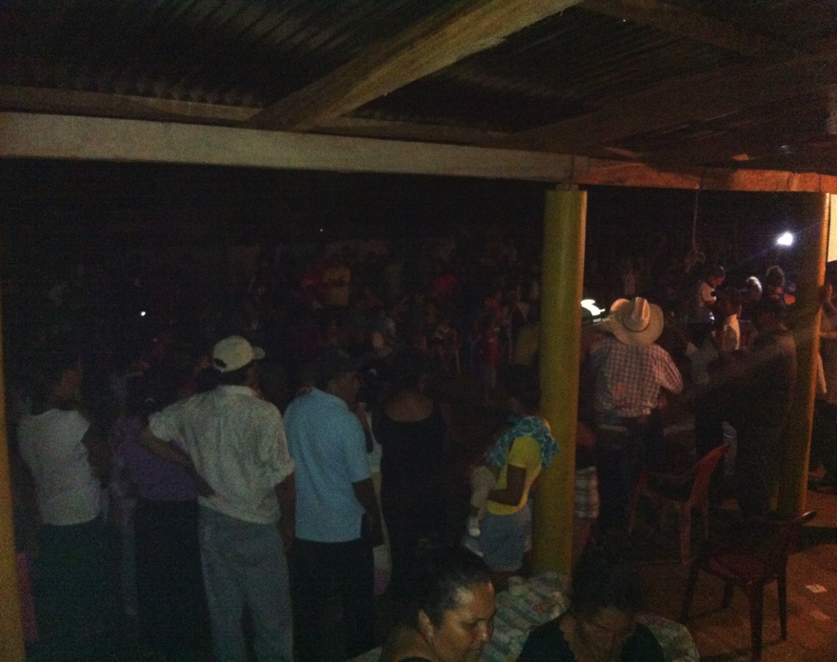
As we were finishing our time in Honduras, the rainy season was approaching and we had to say goodbye with a celebration in the community.
Notes:
----- Meeting Notes (2016-06-02 14:08) -----
-rainy season has begun
-time to wrap up, celebrate and go home

Slide 14
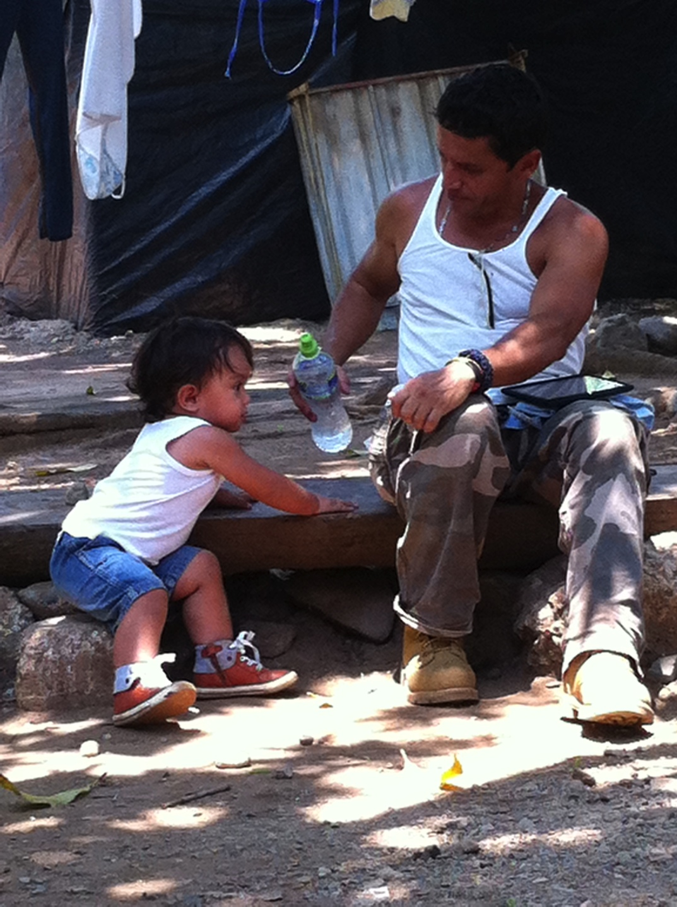
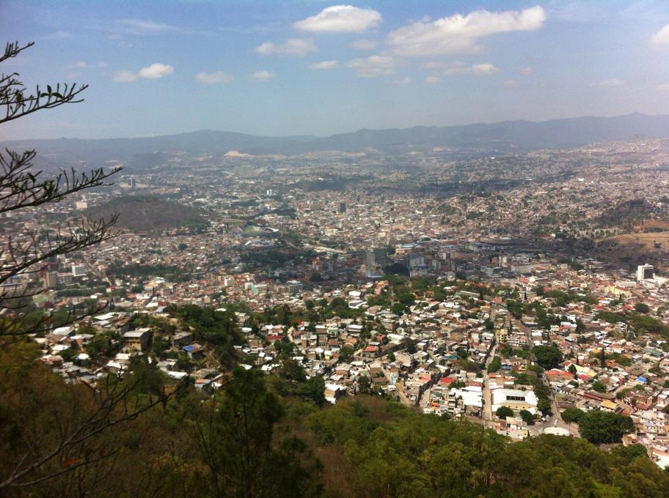
God is present with all, in all areas and acts of life. The great diversity and levels of social standing were seen everywhere, but so was the evidence of God working in their lives.

Slide 15
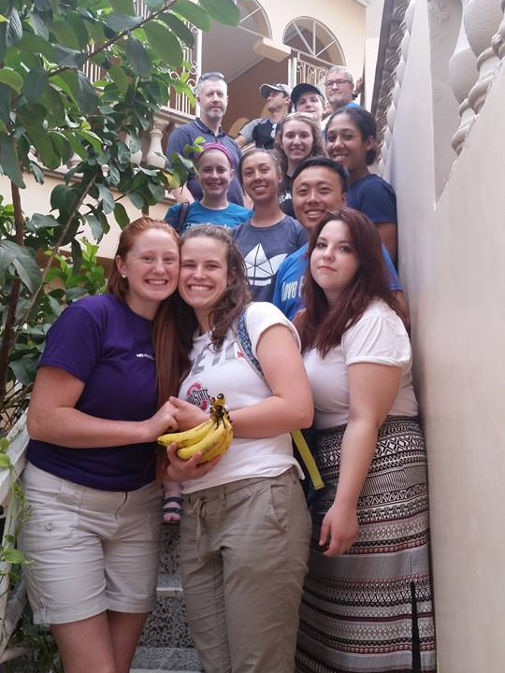
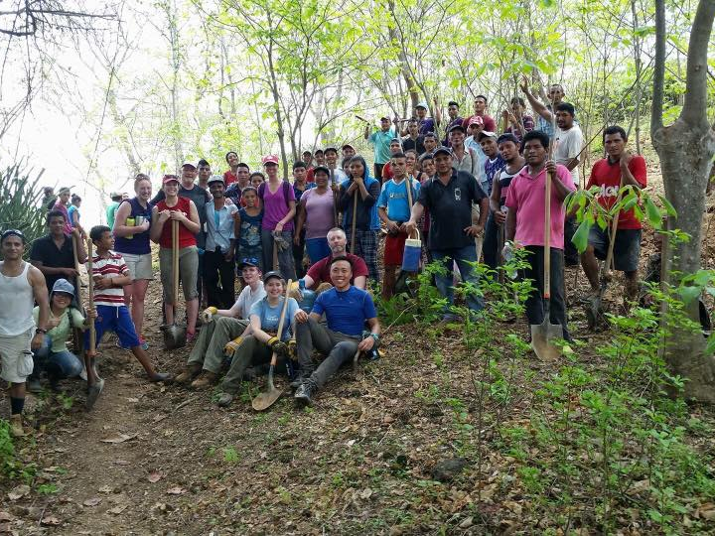
Thank you all so much for your support for me to go on this trip. Without your generosity I would not have been able to go and experience what God had for me and the HWP 2016 team. My time there was so rewarding and appreciated and I look forward to sharing more with you in other ways. - Jesse Edgington

