Slide 1
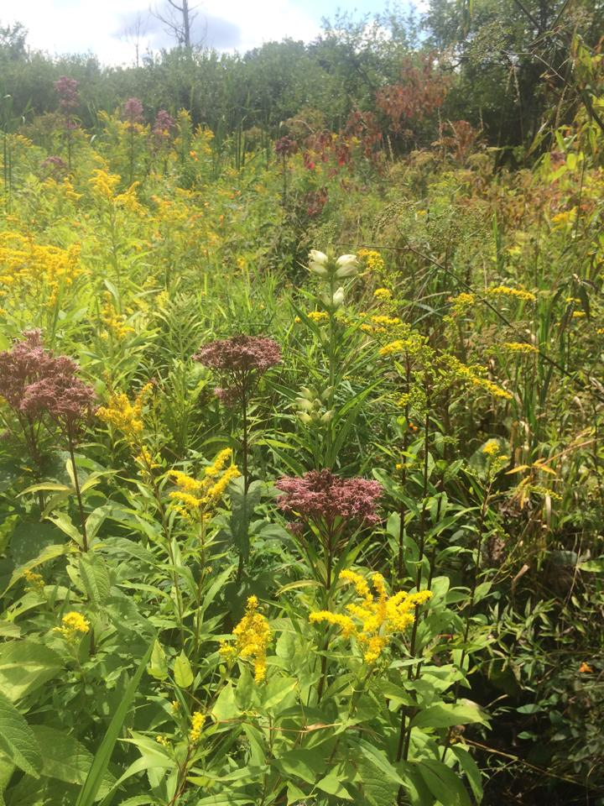
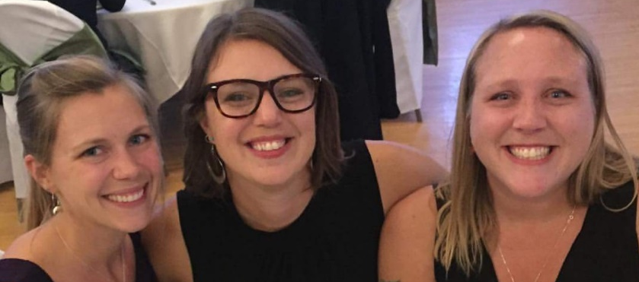
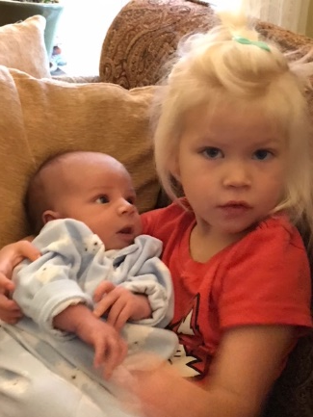
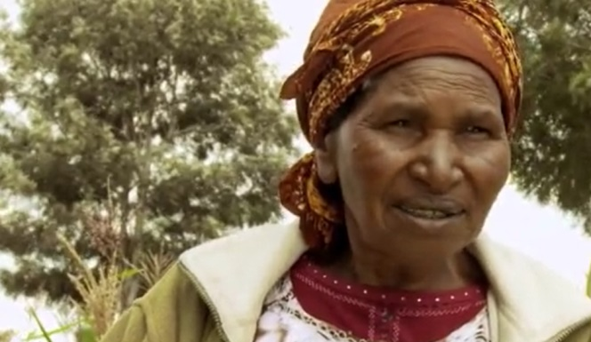
Introductions: Elco Vandergrift
Jesse & Margo:
You:
Insert your name here:
One thing you love about creation?
Why are you hopeful?
Notes:
Video of Elco and brief intro of who we are

Slide 2
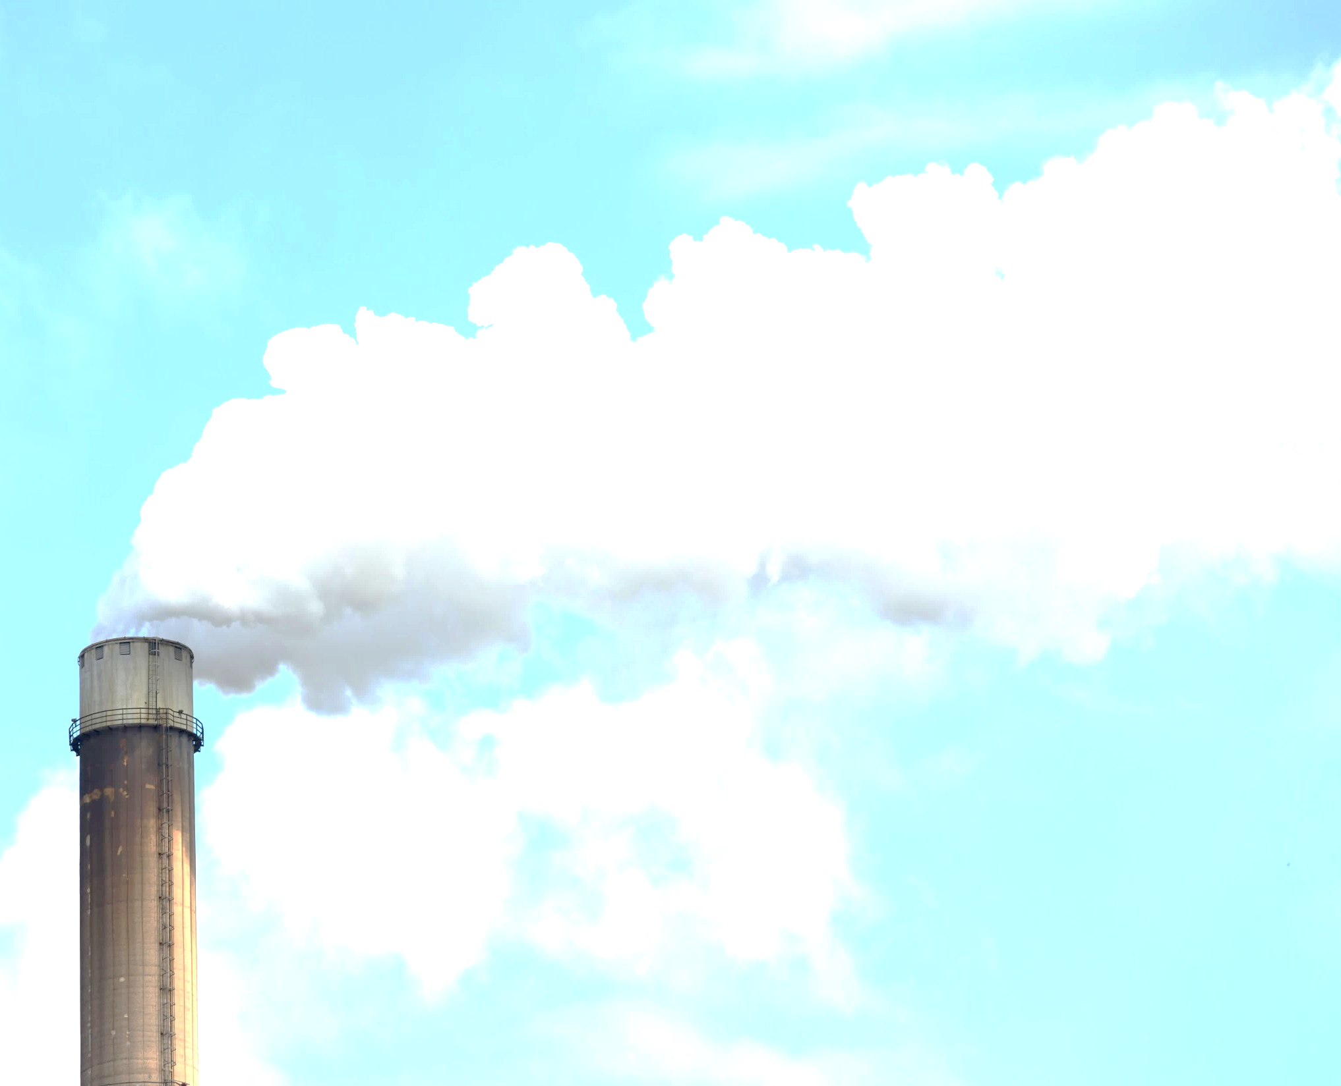
Our Purpose Tonight:
To learn more about the initiatives of the Climate Witness Project
To discover how churches in Classis AB North can get involved
Creation Care… A Place to Start:
Synod 2008 approved an updated version of Our World Belongs to God: A Contemporary Testimony, which identifies climate change as a creation care issue of importance for the church:
51. We lament that our abuse of creation has brought lasting damage to the world we have been given: polluting streams and soil, poisoning the air, altering the climate, and damaging the earth. We commit ourselves to honor all God’s creatures and to protect them from abuse and extinction, for our world belongs to God.
Notes:
Read # 51 together

Slide 3
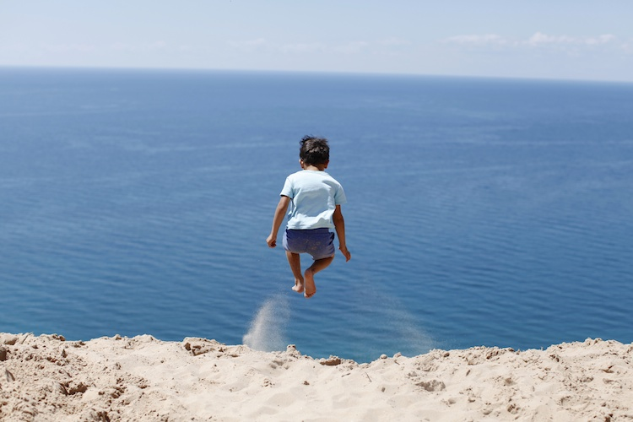
Turn and Talk: Is this lament something we can relate to? Why or why not?
Notes:
3 minutes

Slide 4
What is …?
First, a brief history:

Slide 5
The Denomination’s Position

Slide 6
“It is the current near-consensus of the international scientific community that climate change is occurring and is very likely due to human activity.”
2012 Synodical conclusions from the Creation Stewardship Task Force
“Human-induced climate change is an ethical, social justice, and religious issue. Grounds:
Such climate change poses a significant threat to future generations, the poor, and the vulnerable.
Such climate change poses a significant challenge to us all.
Therefore, action at the personal, communal and political levels is needed to address climate change.
Notes:
Read plus add bullets on Synod sheet

Slide 7
Individual Partners
Congregations/Special Ministries
600
500
400
100
300
75
200
50
100
25
2016
2017
2018
Phase I
Phase II
Phase III
Notes:
Since the start, over three phases of directed action and leadership, the CWP has been growing in Canada and the USA to encourage individuals and congregations to make conscious efforts to learn about the challenges and take some form of positive action where possible.

Slide 8
CLIMATE WITNESS PROJECT
Energy Stewardship
Education
Advocacy
Worship
Notes:
So What is CWP doing? Seeking to find committed partners, congregations and special ministries, who are working to take action through:

Slide 9
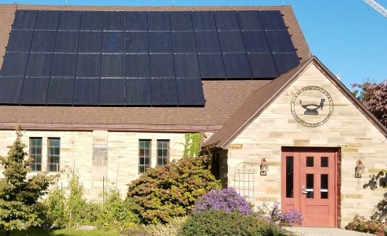
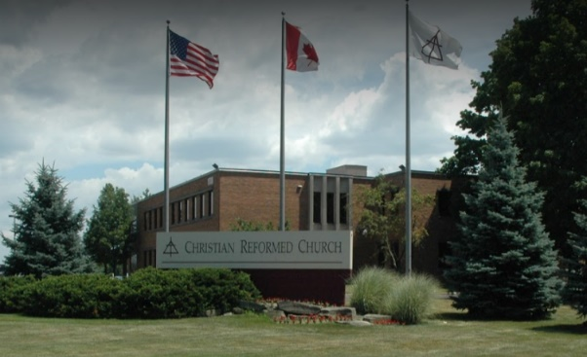
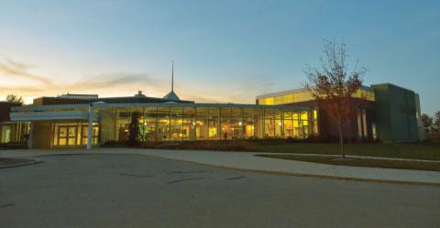
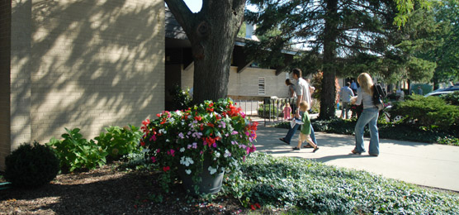
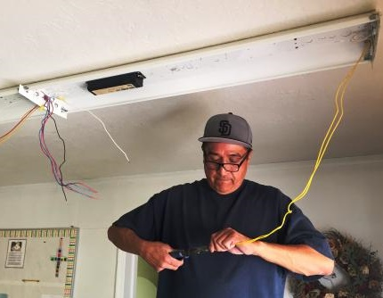
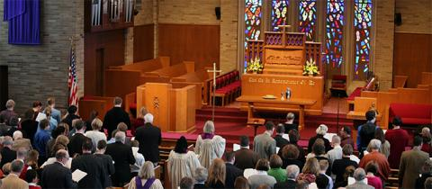
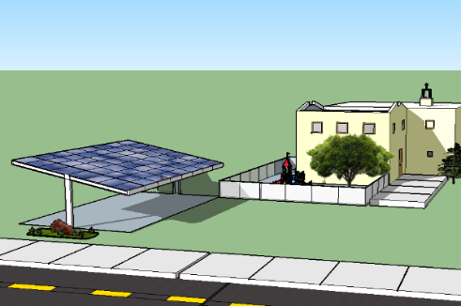
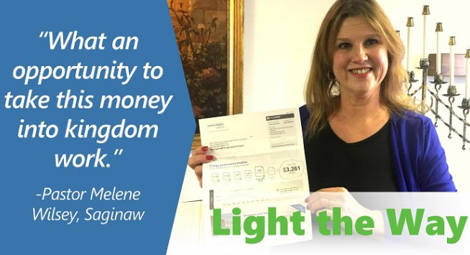
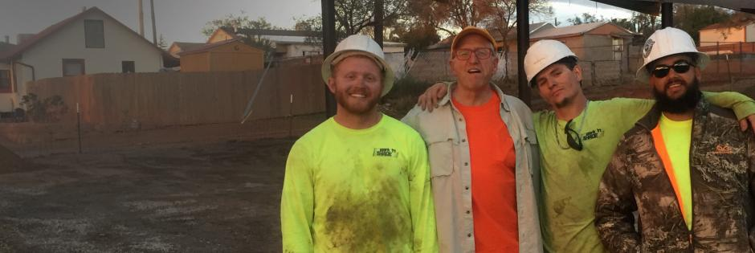
Energy Stewardship
Notes:
Energy Stewardship (reducing the congregation’s use of fossil fuels)

Slide 10
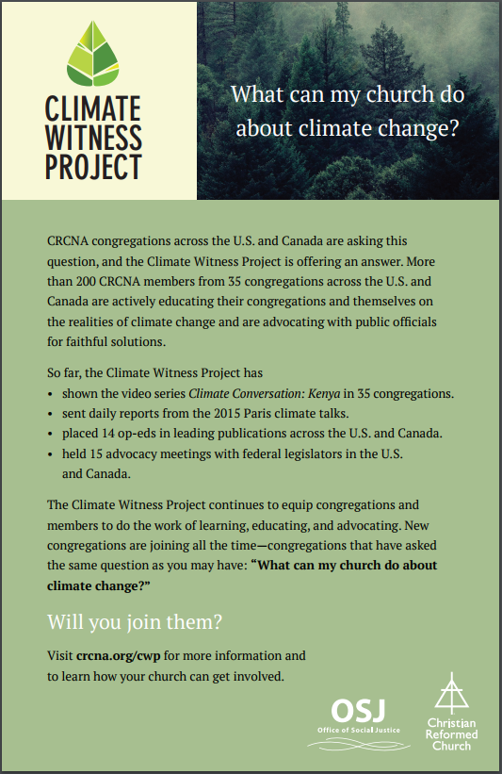
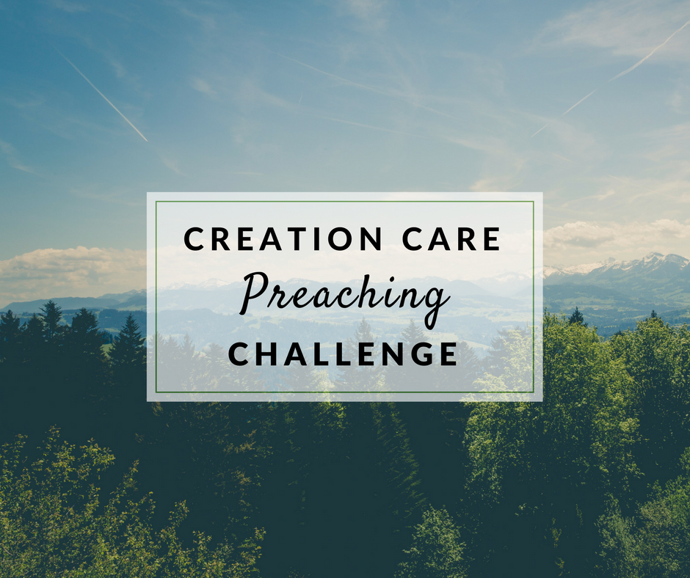
Worship
Worship
Resources
Notes:
Worship (healing our relationship with creation through liturgy, song, scripture and preaching)

Slide 11
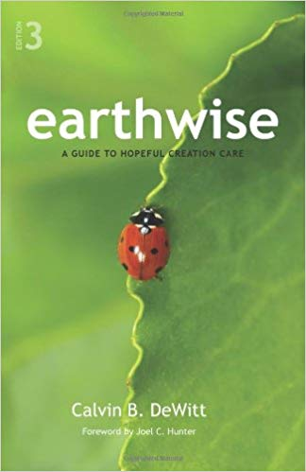
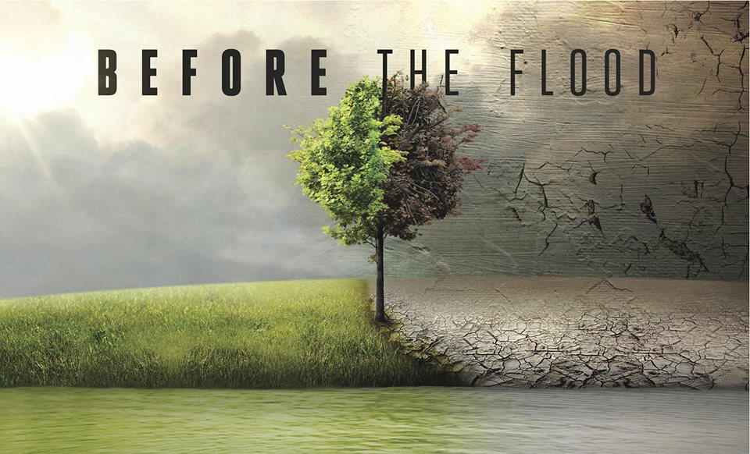
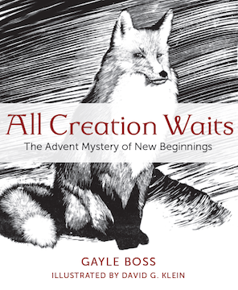
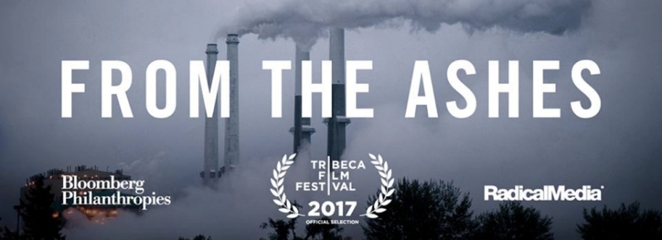
Education
Notes:
Education (book studies, films, discussions, and speakers on creation care. Also adding new resources to your church libraries.)

Slide 12
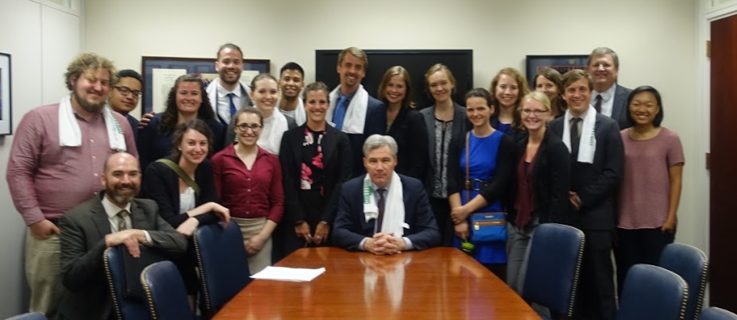
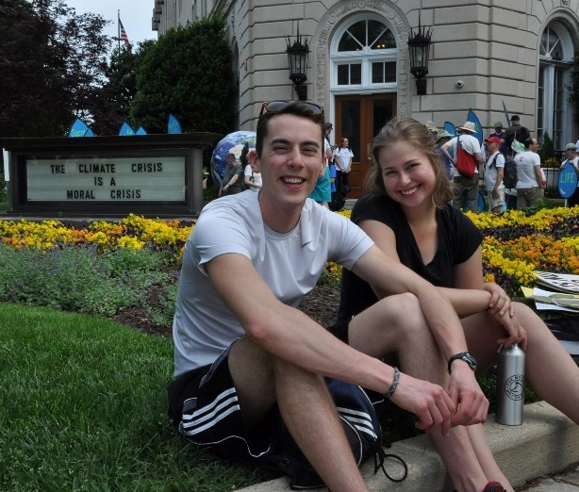
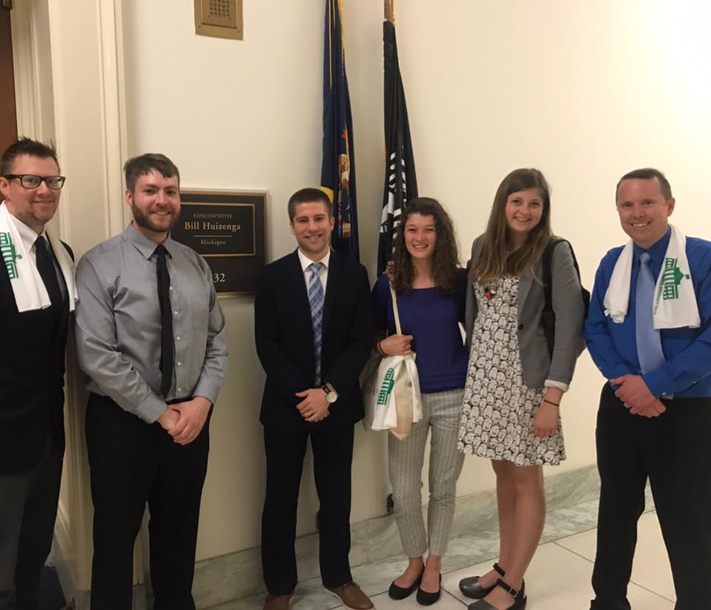
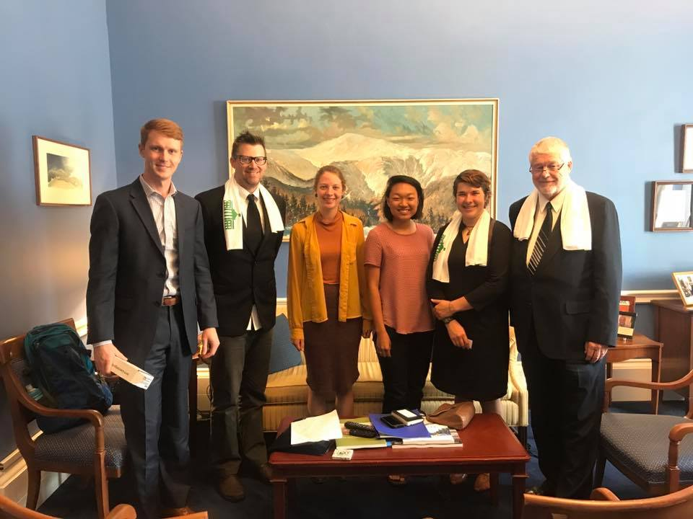
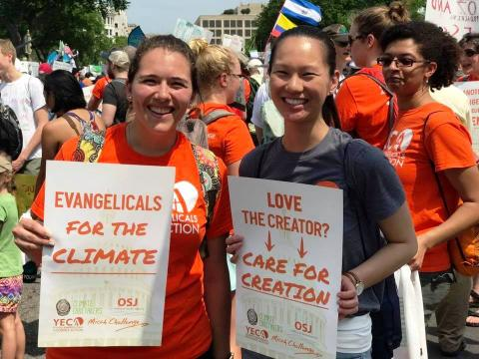
Advocacy
Notes:
Advocacy (impacting public policy at the local, regional, and national levels)

Slide 13
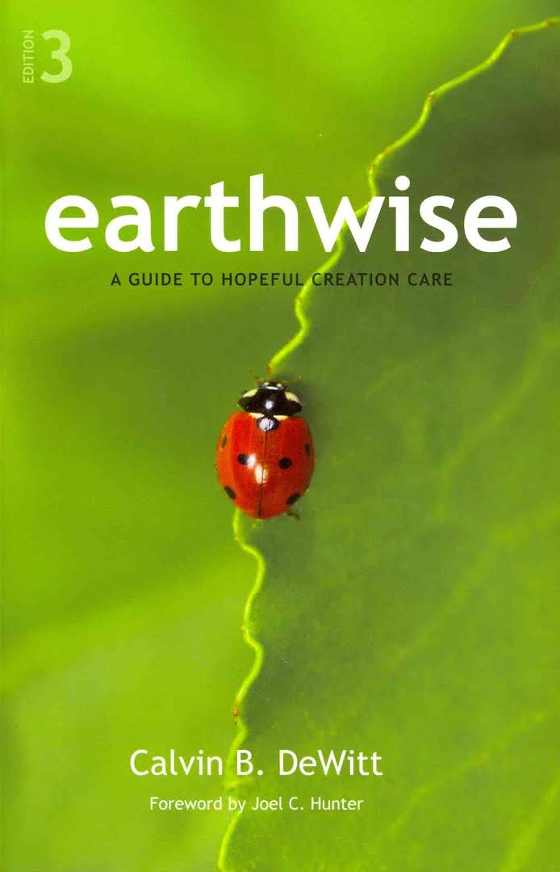
Creation Care to Climate Witness Project West End CRC
2013 Creation Care Small Group

Slide 14
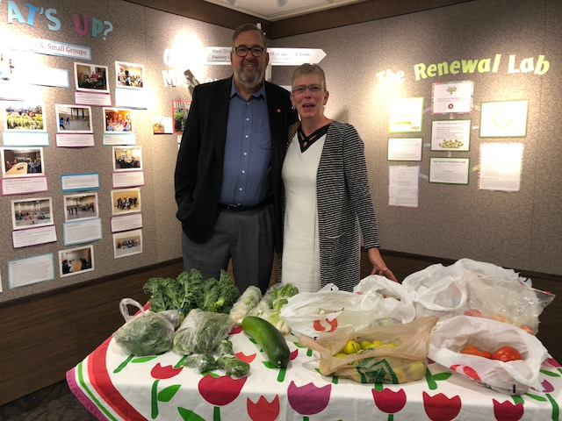
Harvest Table

Slide 15
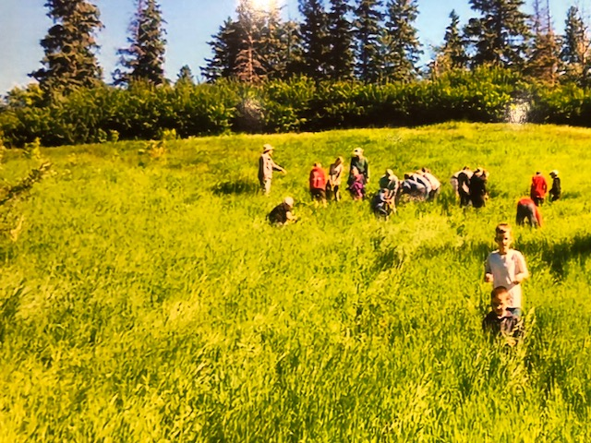
Tree planting in the River Valley

Slide 16
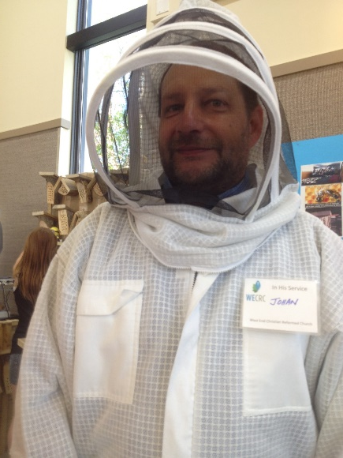
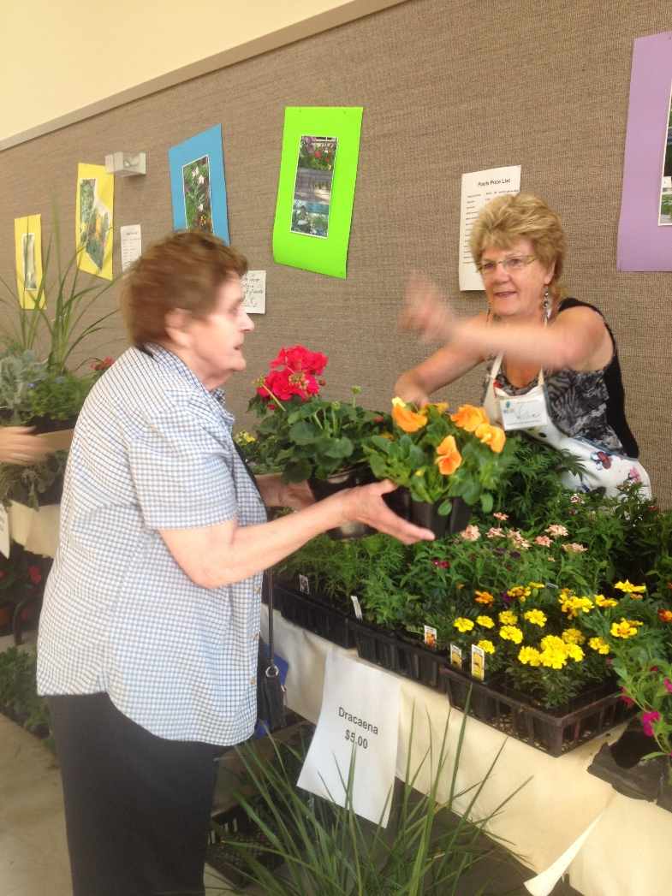
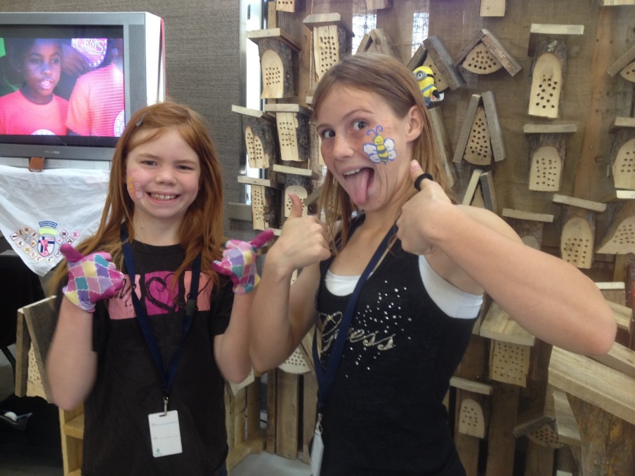
Celebrate Spring with Plants and Bee Boxes

Slide 17
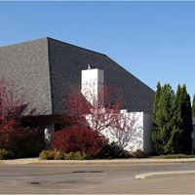
Solar Panels?

Slide 18
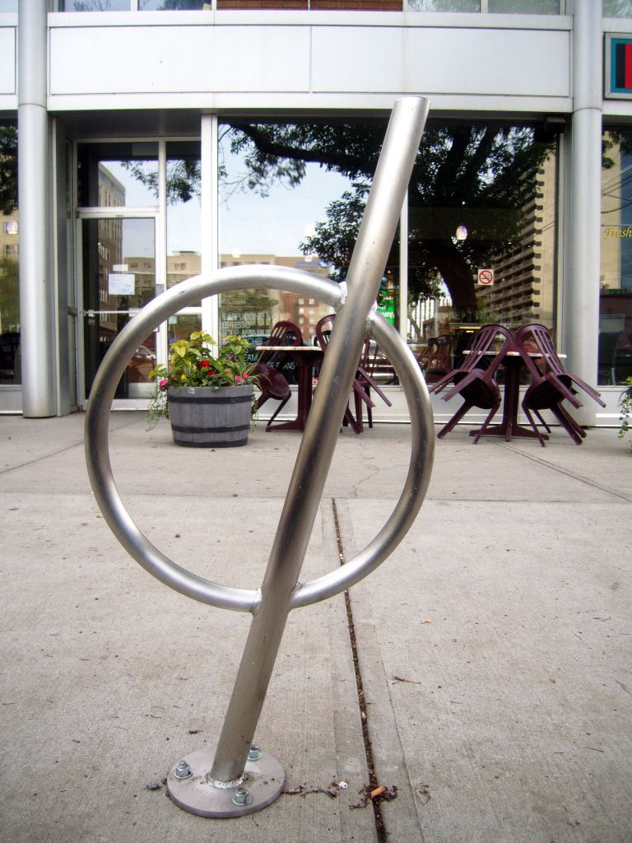
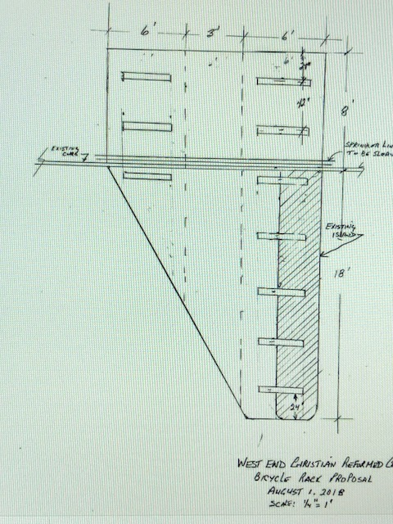
Bicycle racks

Slide 19
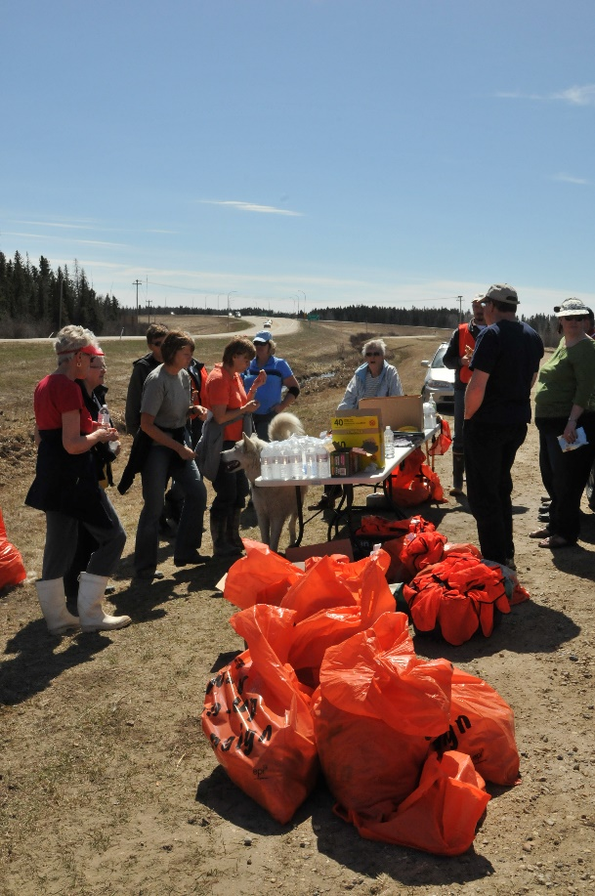
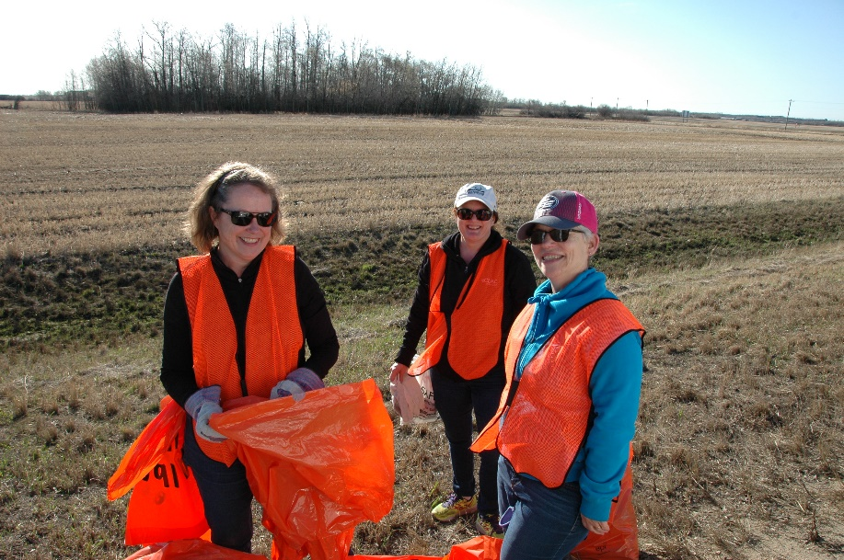
Highway Cleanup

Slide 20
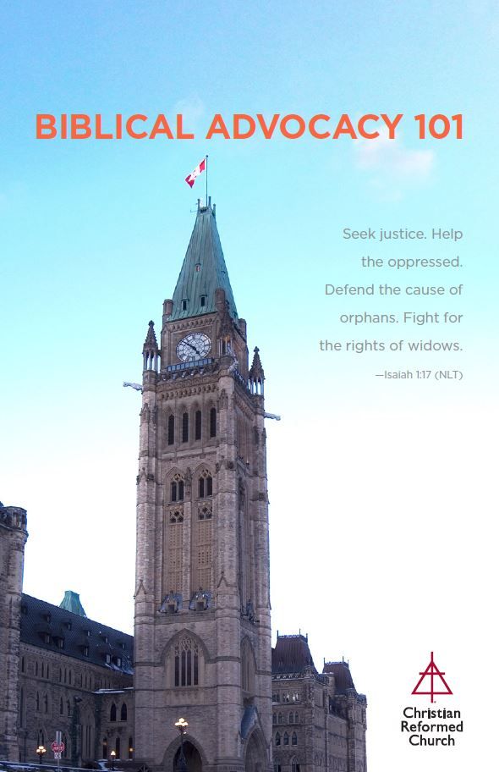
Advocacy Workshop – October 27
9:30 – 3:30
West End CRC
10015 149 St. Edmonton
Registration: $10.00 (lunch included)
Contact Margo DeMoor
demoors@shaw.ca

Slide 21
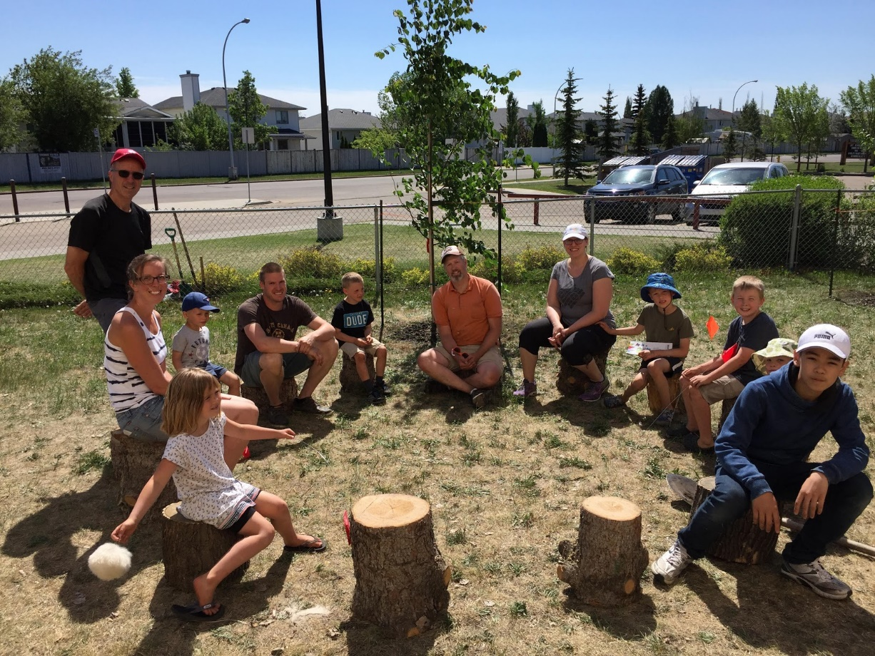
All Things New’ Children’s Nature Space at Centrepointe Community CRC
Notes:
Have replaced lighting in offices with LED lights, celebrated earth day by building bee hotels, added fruit shrubs, trees and composting bins to Children’s Nature Space.

Slide 22
What are you or your church doing that would align with creation care or any of these four pillars from the CWP?
Notes:
We know that many of you may already be doing things along creation care lines or have done so on your own. Take a few minutes to discuss this with one or two people sitting beside you.

Slide 23
What is a CWP Partner?
Endorse
Receive
Intend
Notes:
On your handout you will see some information to take back to your councils, leaders and/or someone you may be able to identify as a champion for this work in your congregations. To be a CWP partner is to be a person or church who will: Endorse the 2012 CRC Synod’s Creation Stewardship Task Force’s Report. Agree to receive electronic communications from the Climate Witness Project, including newsletters, action alerts, updates on what CWP congregations are doing, and more. Intend to do something to address climate change. We don’t presume to tell you what you need to do. Instead, the CWP is hoping to create a network of congregations and individual Christians who will share ideas and experiences around: 1) Energy Stewardship, 2) Worship, 3) Education, and 4) Advocacy.

Slide 24
Take the last five minutes to brainstorm ideas of what you can do to take that first/ next step (or leap)!
Notes:
We know that many of you may already be doing things along creation care lines or have done so on your own. With the info we have presented tonight and the handout to generate some ideas, take the last few minutes to discuss with a neighbor one thing you can identify to take a step towards action.

Slide 25
Notes:
(Intro to it) As Christians, we affirm that the earth is the Lord's and that God is the Creator of all things. We see the many ways that creation reveals God's glory and draws us closer to God. But we also see the brokenness of the earth brought about by sin. While Christ is the one who has reconciled us with God and is setting all things right, we are called to be his disciples, joyfully loving and serving God, our neighbors, and all of creation, for our reconciliation in Christ makes us yearn for the reconciliation of the entire created order. Lets end by joining in the following prayer together. The light color will be read by Margo and the bold color will the the response of the group:

Slide 28
Thanks!

